Slide 1
VIDEOGRAPHY WORKSHOP
Videography from start to finish
By Easton Davis, Canon for Communications and Digital Evangelism

Slide 2
FOOD FOR THOUGHT
“The congregations with the richest and most affirming theology are the worst at getting their messages out to the world, and the congregations with the most harmful theology are the best at celebrity creation and getting their message out to the world.”
-Brandon Cox
Notes:
From my friend Brandon Cox - an ex-evangelical who worked with Rick Warren

Slide 3
FOOD FOR THOUGHT
“83% of media across social media in 2022
was video media”
-LinkedIn
Notes:
From my friend Brandon Cox - an ex-evangelical who worked with Rick Warren

Slide 4
WHY VIDEO?
Video has taken priority over stills
The infrastructure for video continues to grow
TikTok and Reels are examples of video growth
Video increases engagement across social platforms
Younger generations are interested in the video presented on your channels and website
It is another way to share a story - and when mastered can be faster than writing a story
Notes:
Video has taken priority over stills
The infrastructure for video continues to grow
TikTok and Reels are examples of video growth
Video increases engagement across social platforms
Younger generations are interested in the video presented on your channels and website
It is another way to share a story - and when mastered can be faster than writing a story

Slide 5
GEAR OVERVIEW
Your phone
Easiest tool to use that you always have with you
Whether iPhone or Android, it is pro level when matched with pro audio
Cameras
GH5
G85
Uses Micro 4:3 lenses or EF glass with adaptor
Great intro lens: Panasonic 25mm (50 equiv)
Telephoto lens: Olympus 40-150mm
Notes:
Cameras
GH5
G85
Use Micro 4:3 lenses OR EF glass with adapter
Panasonic 25mm
Telephoto 40-150mm

Slide 6
GEAR OVERVIEW
Canon RP
Uses RF lenses or EF lenses with adapter
Great intro lens: RF 50mm
Telephoto lens: 70-200mm
Pros and Cons of both:
Panasonic is geared more for video
Canon is geared more for photo
Panasonic has cheaper bodies but less glass options
Canon has more expensive bodies but is more universal
Notes:
Canon RP
Uses RF lenses OR EF lenses with adapter (cheaper)
Canon RF glass 50mm
Telephoto lens 70-200mm
Pros and Cons of both:
Panasonic is geared more for video
Canon is geared more for photo
Both can be used for either application
Panasonic has cheaper bodies but less glass options
Canon has more expensive bodies but is more universal

Slide 7
GEAR OVERVIEW
Audio
Tascam DR-10L: All in one audio recording system
Rode NTG2: The golden standard of shotgun mics
Zoom H5 or H6: Plug and play audio recorders
70% of people will deal with poorer video quality if audio is good
Notes:
Tascam DR-10L
This is an all in one audio solution
Rode NTG2
The golden standard shotgun mic
Zoom H5 or H6
Plug and play recorders
H5
H6 (4 channels)
70% of viewers will hand with poorer video quality but will ditch it if the audio is poor

Slide 8
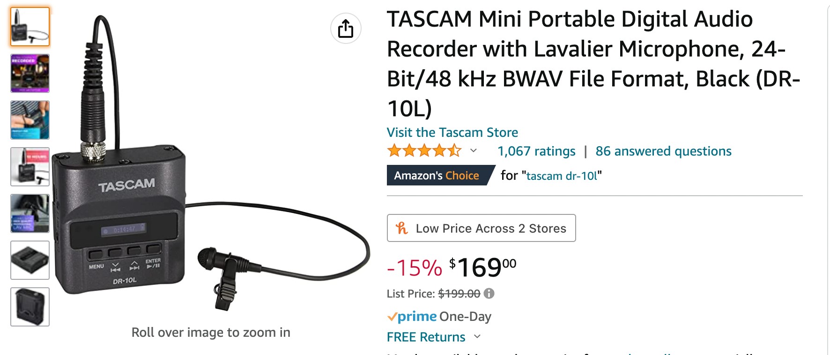
GEAR OVERVIEW
Notes:
Tascam DR-10L

Slide 9
GEAR OVERVIEW
Lighting
Neewer panels for a cheap lighting solution
A cloudy day providers perfect outdoor lighting
The natural light of a nave usually works well
Lighting is the least of the main priorities
Notes:
Lighting
Neewer Panels
Afforable lighting
A cloudy day provides perfect outdoor lighting
Lighting is third on my list behind the quality of audio and video and is a supplemental piece - don’t get hung up on it if you can make do with natural light

Slide 10
OTHER GEAR
Headphones
Tripod(s)
Tripod phone mount
The space always wins
Notes:
Tripod

Slide 11
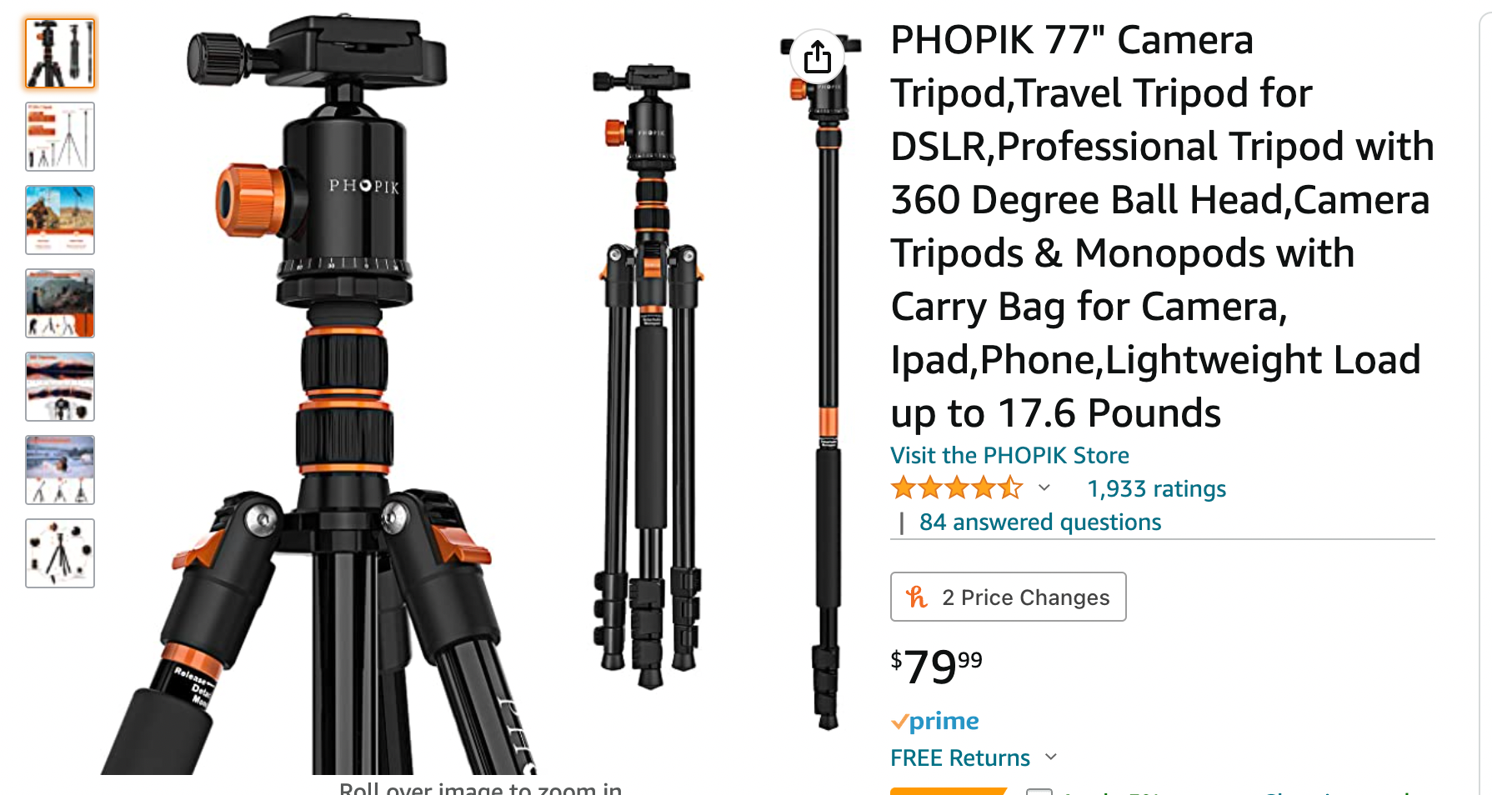
OTHER GEAR
Notes:
Tripod

Slide 12
INVESTMENT
$550-$3000
$550 level
iPhone or Android (outside of $500)
Tripod + Adaptor - $75
Tascam DR-10L - $170.00
Final Cut Pro X - $300
$2500-$3000 - All the above + pro camera + lighting
Notes:
$550-$3000
Tripod phone adaptor
Final Cut Pro X

Slide 13
CAPTURE THE STORY
Define the purpose:
What a Sunday looks like
Testimony from parishioners
Invitation to event
Welcome video
A note from the Rector
Unpacking Episcopal jargon
Notes:
Define the purpose:
What a Sunday looks like
Testimony from parishioners
Invitation to event
Welcome video
A note from the Rector
Unpacking jargon

Slide 14
CAPTURE THE STORY
The story(ies)
What goodness is God doing in your congregation that the world needs to hear?
Notes:
It might be a story of someone struggling with their gender or sexual orientation that found a home in your pews - a priest even.
It might be someone that was working on their power and privilege found a congregation committed to racial healing.
It might be a person that hear the Baptismal Covenant and was moved to tears by the belief that we must strive for justice and to respect the dignity of every human being.
These are but a few examples of the Goodness of God on full display in The Diocese and this is an invitation to bring that message forth into a broken world - a world that needs to know a God that says you are Beloved and you are loved unconditionally by me - and you are chosen by me to sow more of my belovedness into the world.

Slide 15
UNIVERSAL CAMERA SETTINGS
TIme/Date
Make sure it is correct on camera!
Shooting mode(s)
4K at 30 and 60 FPS
Why 4K?
Why 30 and 60?
Why mp4?
ISO
Sensitivity to light
-3 to +3
STOPS for exposure
Creating Bokeh
Depth of field and blurred backgrounds
Manual focus peaking
Make sure everything is in focus!
Use your vertical and horizontal axis
Notes:
Time/Date
Shooting mode(s)
4K at 30 and 60 FPS
Why 4K?
Why 30 and 60? 30 is standard and 60 gives us buttery slow motion
Why mp4?
ISO
Sensitivity to light
-3 to +3
STOPS for exposure
Creating Bokeh
Depth of field and blurred backgrounds
Manual focus peaking
Make sure everything is in focus!
Horizontal axis

Slide 16
POST PRODUCTION
We will cover:
Final Cut Pro X (comp to Premiere Pro)
Post production tips covered:
File management
Using blade, trim, spreading timeline
Audio syncing and multicam
Stacking b-roll and automatic speeds
Using text and cross dissolve
Using opacities and color grading
Exporting
Notes:
We will cover:
Final Cut Pro X (comp to Premiere Pro)
Post production tips covered:
File management
Using blade, trim, spreading timeline
Audio syncing and multicam
Stacking b-roll and automatic speeds
Using text and cross dissolve
Using opacities and color grading
Exporting

