Slide 1
Social Media for Churches
The Essentials

Slide 2
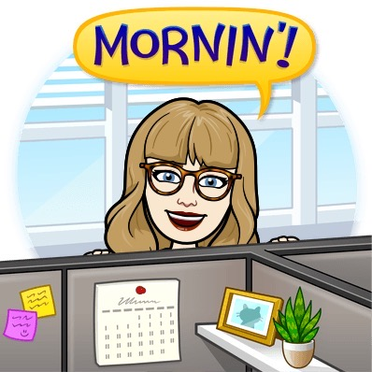
Ellie Singer
social media / multimedia specialist at the Episcopal Diocese of Texas
Perspective I’m bringing today:
Digital native
Digital/communications strategy
2020: helping churches go digital

Slide 3
Intro: Social Media and Faith

Slide 4
Evangelism
Social media is lucrative because people share what they’re excited about
One word:
Let’s give them something to talk about 🎶
Christianity loves these moments:
Roman roads, printing press, Internet
Crossfit

Slide 5
“What are you surprised by?”
“How few churches I've spoken with realize that you need signed consent forms from guardians to post pictures of children and teens on social media.”
“I'm always amazed when a church has given control of their social media accounts (which, I suppose, presupposes the surprising situation in which they *have* them) to someone who grasps the language of said social media. This happens! It is amazing. And surprising.”
“how many churches see twitter or FB as a place to just put information and not a place for community”
“How good the churchome app is. The little two thumb prayer function, and prayer request thread is amazing.”
“how rare it is (pre-COVID mostly) to find a church account with actual photos of congregants/activities/services rather than just announcements/memes/statements. I want to know there are real, tangible ppl who go there lmao”
“That different people use different social media platforms for different reasons. Like, please do NOT have a FB, Twitter, and instagram and just repost the exact same content there. Talk to people who feel at home there! How do people use that space?”
“How hard it is to have local impact. Social media is global. Reaching people in your physical area (with the goal of physical attendance) is hard. Many of our local FB, Twitter, etc., groups are anti-religious and reject any church-related content. Hard to get the word out.”
“How many churches assume that a "bigger" social media presence will naturally equate to "bringing in more young people"”

Slide 6
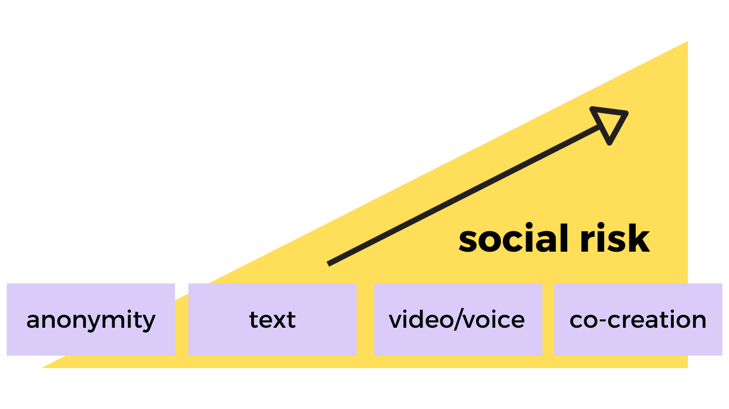
It’s All About Invitation

Slide 7
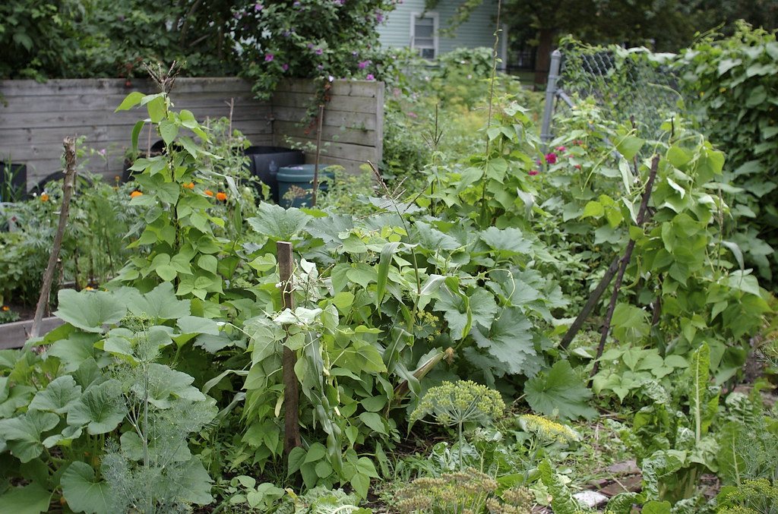
Permaculture Community
What we can learn from the milpa:
Plants just doing their thing produce more than rows of crops
Helping each other with our gifts and talents
“Many to many” model > “One to many”
"The milpa" by JoePhoto is licensed under CC BY 2.0

Slide 8
Part 1: the major players

Slide 9
Stats
2nd most popular social network
71% of US adults use FB (Pew Research)
About four-in-ten adult Facebook users (42%) have taken a break from checking the platform for several weeks or more, and about a quarter (26%) have deleted the app from their phone at some point in the past year.
Those taking these actions skew young dramatically

Slide 10
Why use it?
One stop shop
News
Events
Photos
Groups
Shareability/Evangelism
Popular among churches’ typical demographic

Slide 11
Cautions
Facebook advertiser strike
Information harvesting & selling
(Pew poll: over 50% of users polled did not know this and were uncomfortable)
Exclusionary of those without accounts
Overwhelming interface
Trolls (at least 15% of accounts are fake or duplicates)

Slide 12
Things to Consider as an Admin
Covenants!
“Where should I put this?” - have a plan
Keeping it updated is harder when we use every single feature
Is everything on Facebook but nowhere else?
Overwhelming interface
Translation to/from other platforms: FB tends to happen in full sentence, often paragraph-long conversations with punctuation.

Slide 13
Stats
Owned by FB
110 million Instagram US users
Younger: 34% of Instagram users aged 25-34; 31% are 18-24
3rd most popular social networking app/site
https://www.businessofapps.com/data/instagram-statistics/

Slide 14
Why use it?
Intergenerational, rising popularity
Tells a visual story
Creates a bank of photos
Stories/vertical videos are personal
Culture of sharing posts with friends

Slide 15
Cautions
Facebook cautions apply:
Facebook advertiser strike
Information harvesting & selling
Exclusionary of those without accounts
You get one link, in your bio!
Clipart and text get old
Ethos of consumption

Slide 16
Things to Consider as an Admin
Privacy of those pictured
Visual identity
Stories vs IGTV vs posts
Is there an invitation here?

Slide 17
Stats
Percentage of Twitter users on Mobile: 80%
48.35 million monthly active Twitter users in the US
85% of small and medium business users use Twitter to provide customer service
38% of Twitter users are between the ages of 18 and 29, 26% users are 30-49 years old
https://www.omnicoreagency.com/twitter-statistics/

Slide 18
Why use it?
Intergenerational, active usage
Field questions/comments
E.g. stuffed BCP fundraiser
News
Asynchronous community
Progressive, innovative church discourse

Slide 19
Cautions
Is Twitter your neighborhood?
Institutional Twitter accounts tend to be unpopular unless news or customer-service oriented
Discourse^{tm}

Slide 20
Things to Consider as an Admin
Post frequency
Why would someone follow you?
“Post to Twitter” buttons rarely format well
Join personally to learn the platform before joining as an institution

Slide 21
Part 2: Other Platforms to Consider

Slide 22
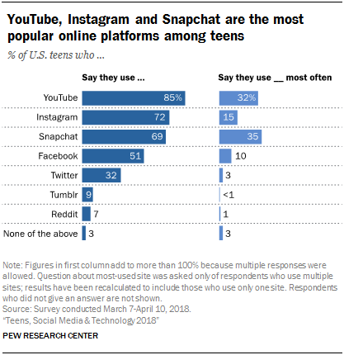
The Future of Social Networking

Slide 23
Good options to research if you’re interested:
Chat/forum where teams can discuss topics asynchronously or meet in video/voice calls in-app. Each “server” is divided into rooms (“channels”) which helps facilitate multiple simultaneous conversations
Discord (free, community-oriented)
Slack (paid, business-oriented)
Post videos in a social setting where subscribers get alerts, comment, and reshare. Here you can organize your video content into playlists.
YouTube (most popular social network, status updates, public, easy to navigate)
Vimeo (less social, users can download, interactive elements, less organic discovery)

Slide 24
Get local!
NextDoor
Yelp
Google Business
TripAdvisor
Search yourself in incognito mode and see what pops up
Invite a digital “secret shopper”

Slide 25
Part 3: General Tips & Strategies

Slide 26
Use a visual identity
Will make your life easier!
Choose two fonts and a color scheme in Canva
Take good pictures often
(big secret of photography: take a bunch of pics and one will stick)
Ask for submissions
Walk toward the subject to zoom
Be aware of emptiness
Name and file on a shared drive

Slide 27
Keep the Keys
Save passwords where multiple people have access
Always register accounts and domains under the church’s official email address
Report imposters

Slide 28
Set personal boundaries
every single social network
(burnout & dead accounts)
using one well
(exclusion & inflexibility)
Be intentional about the middle ground - start with our mission, with the “who”
Know your troll policy before it happens
It’s okay to step away

Slide 29
Use Free 3rd-Party Tools
Premium Canva is free for nonprofits
Hootsuite, Buffer, etc. for scheduling campaigns
Depending on your website, there may be integrations
Eyedropper browser extension to grab colors quickly

Slide 30
Stay curious!
Most things in this presentation will change
Use Google and YouTube to search tech/strategy questions
E.g. “how to discord beginners” in YouTube
Explicitly ask your community for feedback, often

