Slide 1
Emotional Marketing
How it can apply to church communications
Wilson Chu
April 28, 2021

Slide 2
Personas

Slide 3
Fictional, generalized representations of your ideal customers.
Personas help you understand your customers (and prospective customers) better, and make it easier for you to tailor content to the specific needs, behaviors, and concerns of different groups.
Source: Hubspot Buyer Persona Guide

Slide 4
Allow you to personalize or target your marketing for different segments of your audience.
Source: Hubspot Buyer Persona Guide

Slide 5
What details are in a persona?
Demographics (age, gender, location)
History (previous or current faith/churchgoing status)
Goals (what they hope to get out of a church)
Pain points (challenges in life that lead them to see value in joining)
Triggers (why they might join a church for the first time or start to look for a new congregation)
Dispositions (tech-savvy vs. old-fashioned, active vs. sedentary, natural leader vs. quiet participant, etc.)
Framework by Forrest Hersom at Gloo

Slide 6
Gabriel Mesa
Church Buyer Persona
Demographics Age? Income? Location? Gender Identity?
Pain Points Challenges in life that lead them to see value in joining a church
Age 35
$150,000
Oakland, CA (Just moved there 2 months ago)
LGBTQ+
Lost strong foundation in Christ since leaving church
Dispositions tech-savvy vs. old-fashioned, active vs. sedentary, natural leader vs. quiet participant, etc.
Triggers why they might join a church for the first time or start to look for a new congregation
Tech-Savvy
Active
Quiet participant
Former church not accepting of his family
History Job? Family? Lifestyle? previous or
current faith/churchgoing status?
Goals What they hope to get out of church?
Software engineer
Married, father of 2
no longer goes to church
Find a church that treats him like family
Looking to make new friends
Framework by Forrest Hersom at Gloo

Slide 7
Kate Lee
Church Buyer Persona
Demographics Age? Income? Location? Gender Identity?
Pain Points Challenges in life that lead them to see value in joining a church
32
$60,000
Denver, CO
Female
Reconnect with her childhood faith, but not with the Catholic Church
Part of avid cycling group
Social justice (reconcile with religion)
Dispositions tech-savvy vs. old-fashioned, active vs. sedentary, natural leader vs. quiet participant, etc.
Triggers why they might join a church for the first time or start to look for a new congregation
Tech-savvy
Active
Natural leader
Went through a divorce
New to the area
Kids have grown up. Have more time for church
History Job? Family? Lifestyle? previous or
current faith/churchgoing status?
Goals What they hope to get out of church?
School Teacher
Grew up Catholic, and is disillusioned.
Community
Spiritual practices
Framework by Forrest Hersom at Gloo

Slide 8
Creating content that connects

Slide 9
Knowing Your Audience (Use Personas)

Slide 10
Tell A Compelling Story that Connects

Slide 11
Create or curate images and/or video

Slide 12
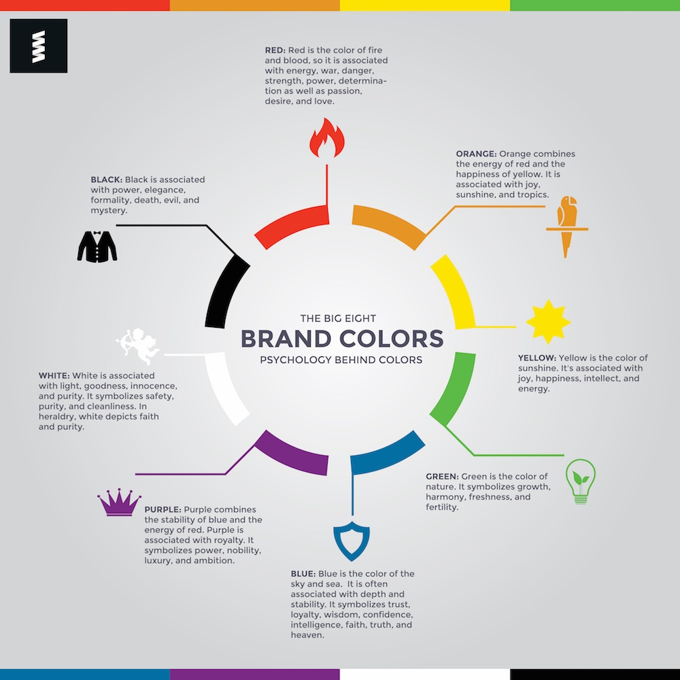
Source: Color Wheel Pro

Slide 13
Create compelling messaging

Slide 14
Notes:
Fundraising campaign when we talk about society’s underdogs. I wanted the photos to show who they are.

Slide 15
Notes:
Diversity collage. Diverse congregation.

Slide 16
Wilson Chu
Social Media and Content Manager
wilsonchu.com
wchu62@gmail.com
linkedin.com/in/wilsonchu62

