Slide 1
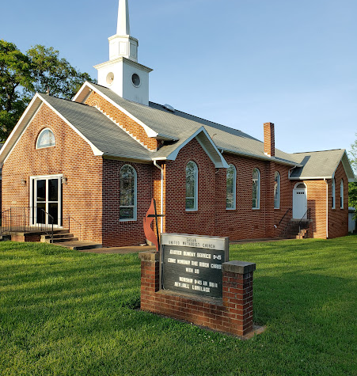
Communicating in the Rural
Utilizing Our Traditional Means of Communication to Build the Kingdom

Slide 2
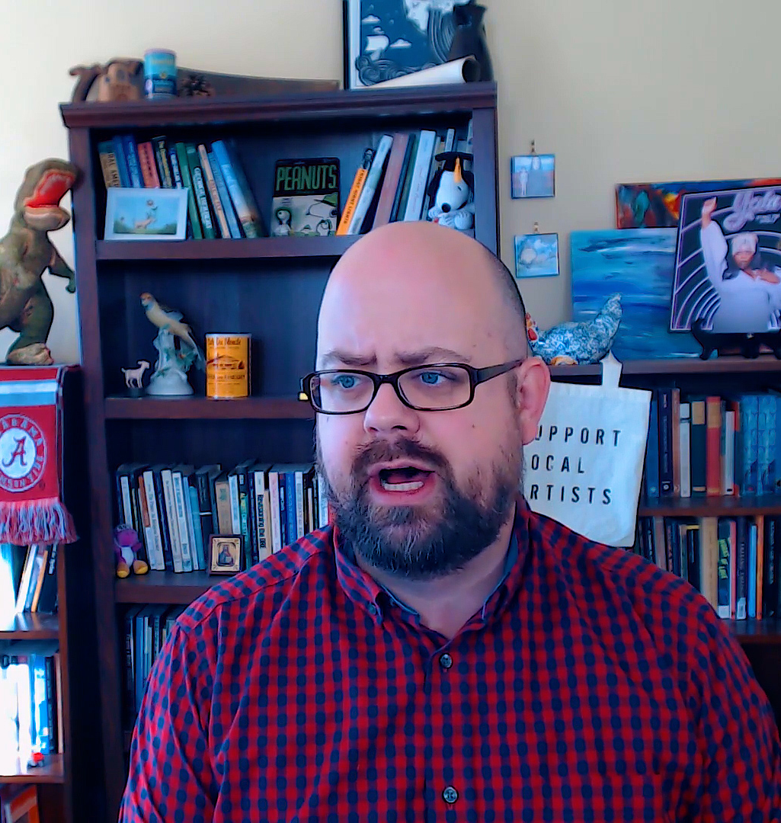
About Me: Jonathan LeMaster-Smith

Slide 3
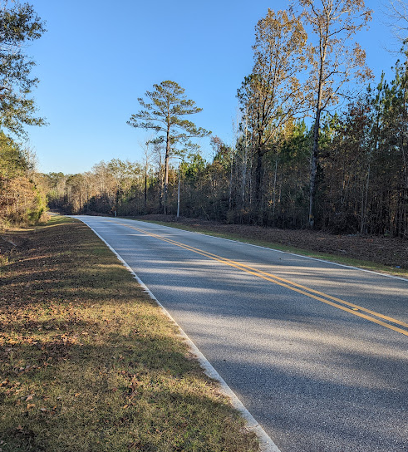
Rural Cultural Values
Stewardship
Deep Place Sensitive Knowledge
Making Do
Continuing the Story

Slide 4
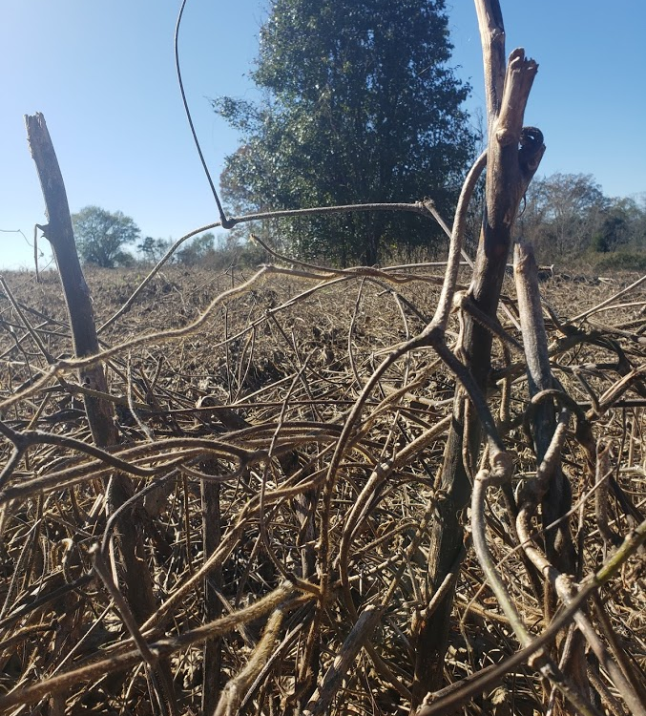
Oral Communication
Blending story, heritage, and experience
Proverbs and Anecdotes
Communal NOT Committee
Decisions are made over time
Connection through Action
Community Good NOT Common Good

Slide 5
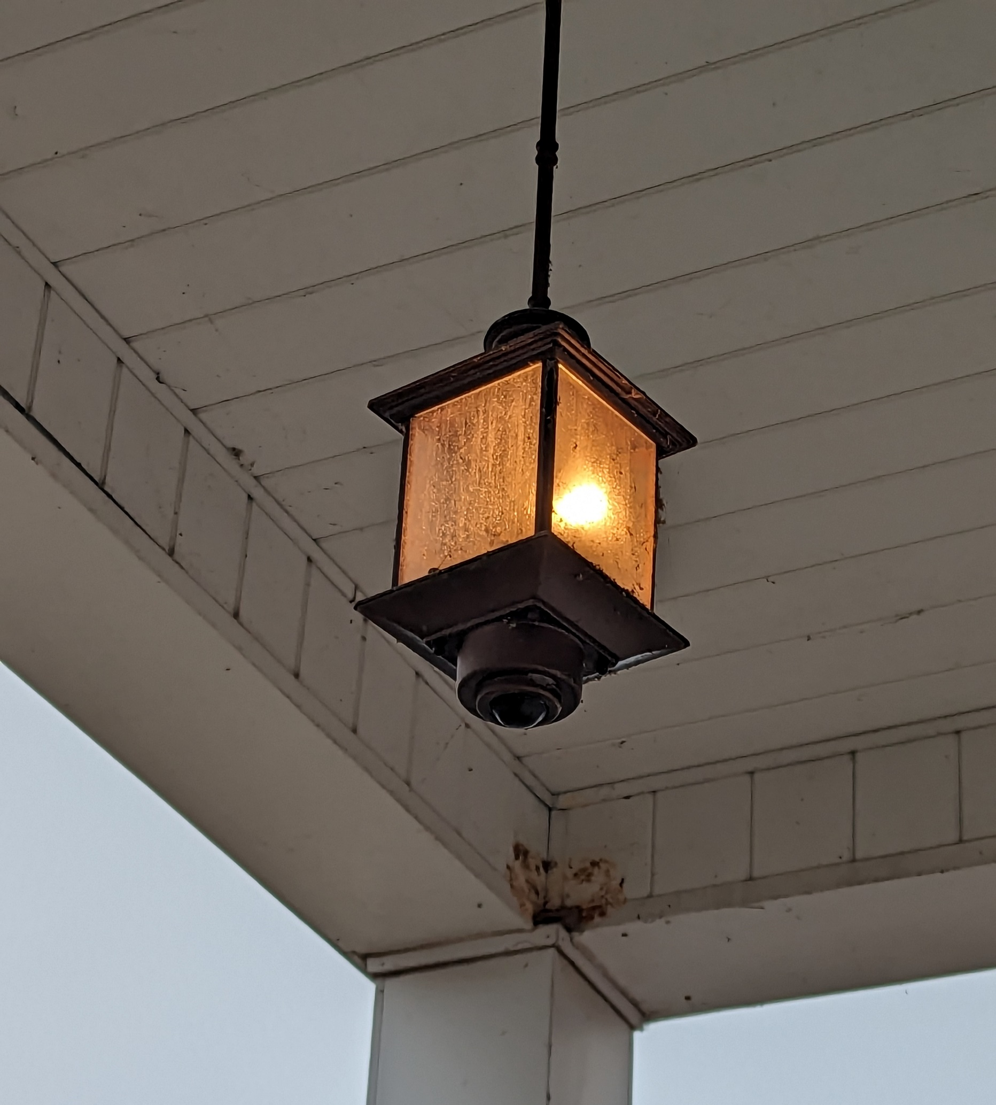
Communicate:
Story
Connection
Cause

Slide 6
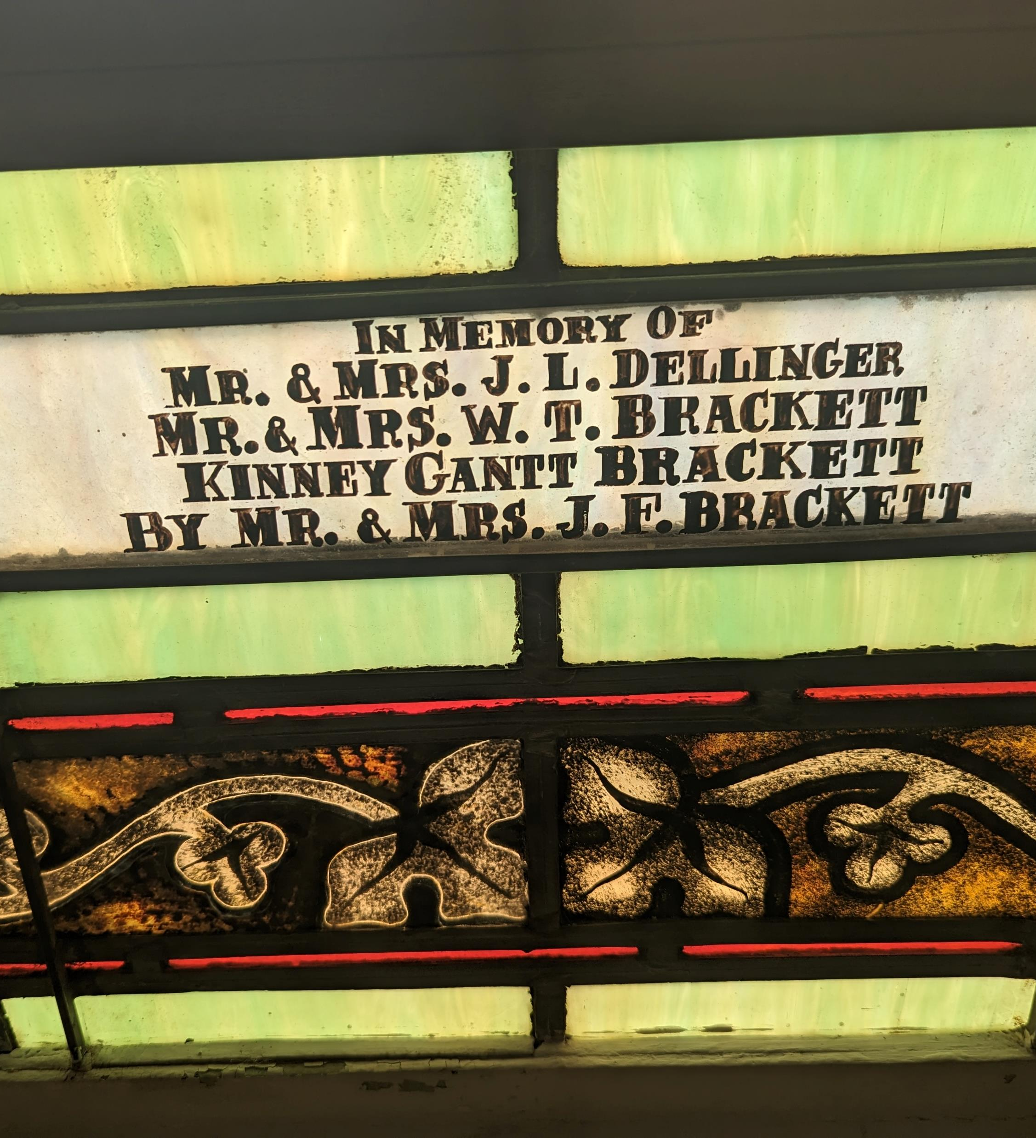
Communicate the Gospel Through Our Heritage

Slide 7
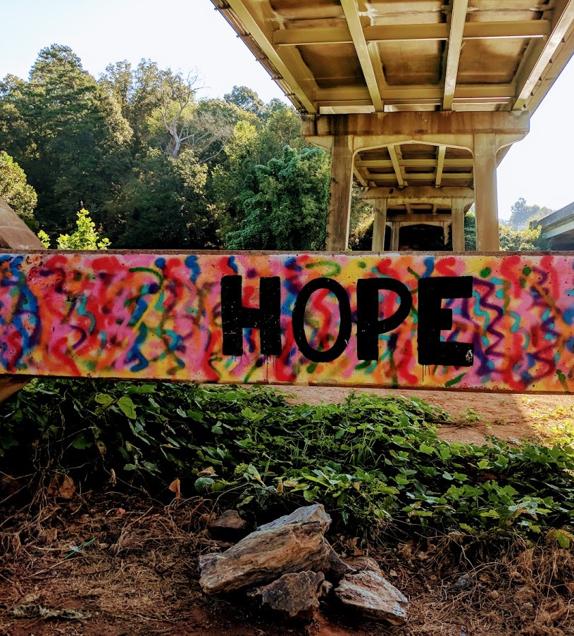
Communicate the Gospel Through Visitation

Slide 8
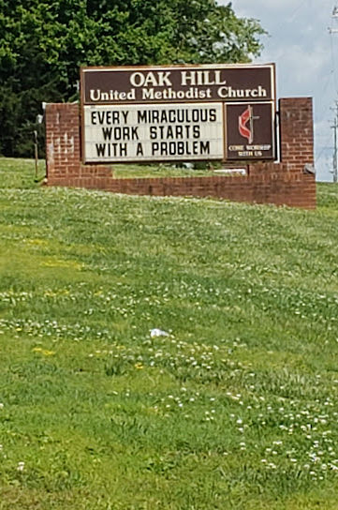
Communicate the Gospel Through Invitation

Slide 9
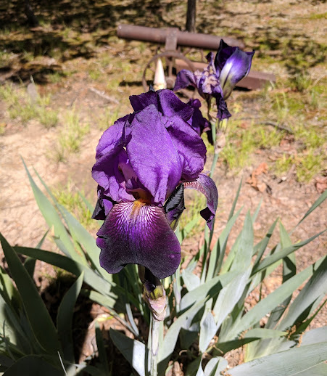
Communicating the Gospel through Information Hubs

Slide 10
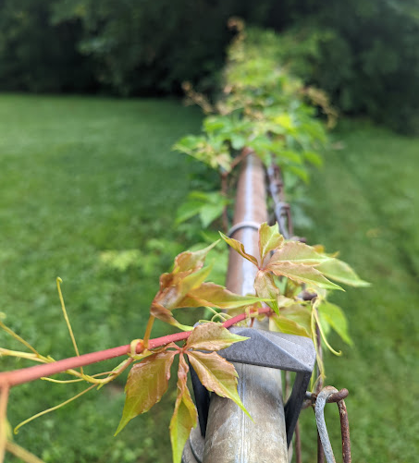
Communicate the Gospel Through Action

Slide 11
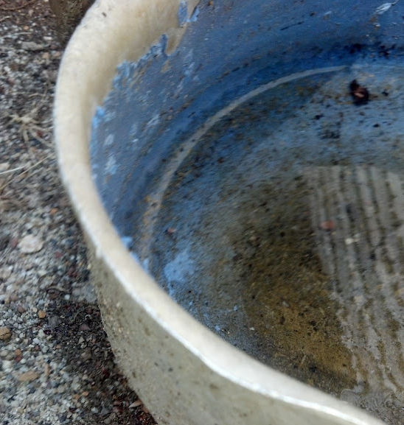
Communicating the Gospel Through Gossip

Slide 12
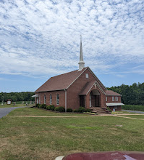
Communicating With Minimal Internet: Myths
Every Church Should Be Streaming the Service
Every Church Should Have A Huge “Tech” Team
Every Church Needs An Elaborate Website
Every Church Needs Dozens of Online Offerings

Slide 13
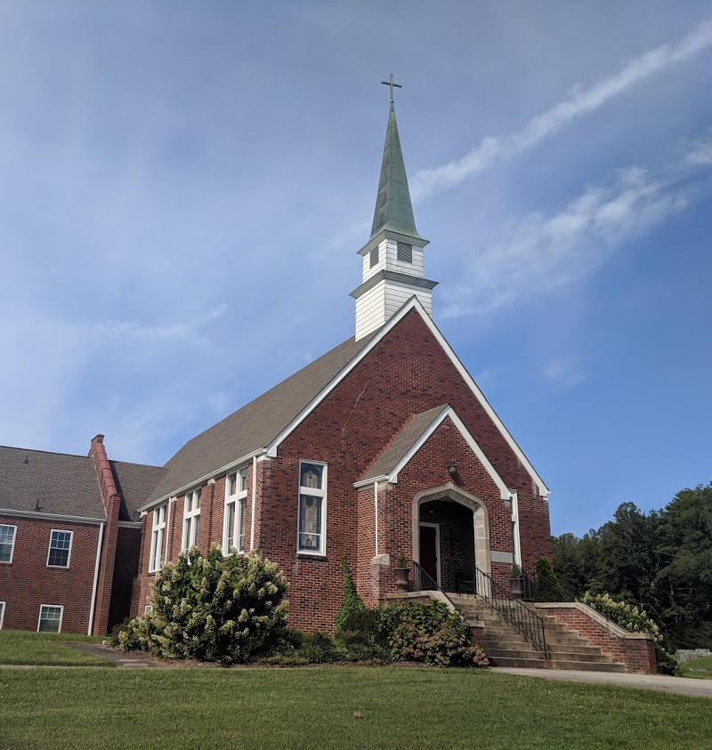
Communicating With Minimal Internet: External Space

Slide 14
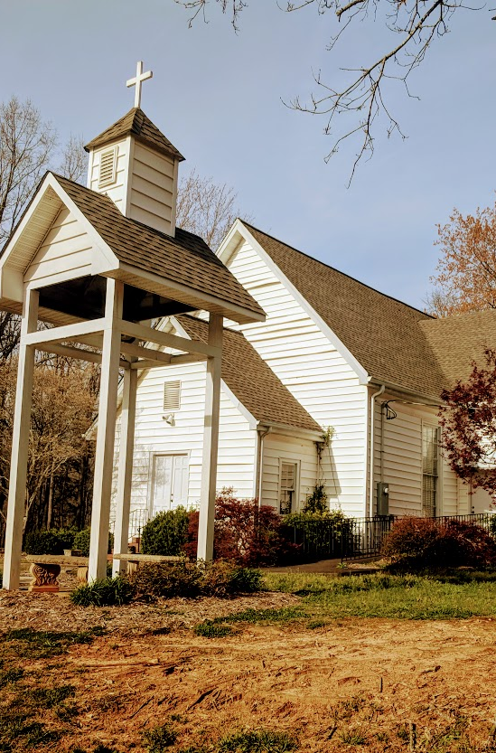
Communicating with Minimal Internet: Direct Communication

Slide 15
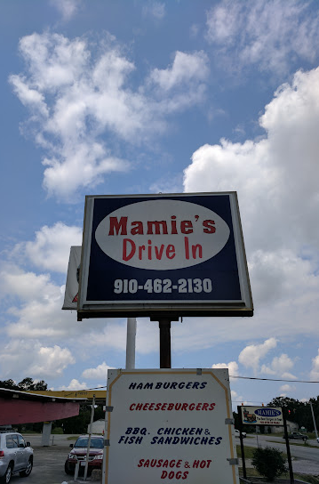
Communication With Minimal Internet: Communication Hubs

Slide 16
Communication with Minimal Internet: Quid Pro Quo

Slide 17
Questions and Comments

Slide 18
Social Media in the Rural Church
People share what fits their story
Memes, Family Updates, Stories, Recipes, Videos
Treat it as a community hub
What’s going on over Timberline Road?
Boundaries are Blurred
Businesses, People, Politicians all Act the Same
Everything Is Public
If it’s real, it goes on Social Media

Slide 19
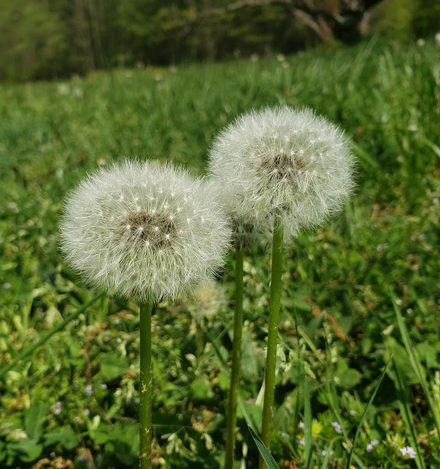
Facebook Basics Pages vs. Posts
Pages
Posts
Pictures
Events
Groups
Internal Events
Meeting Announcements
Particular Announcements

Slide 20
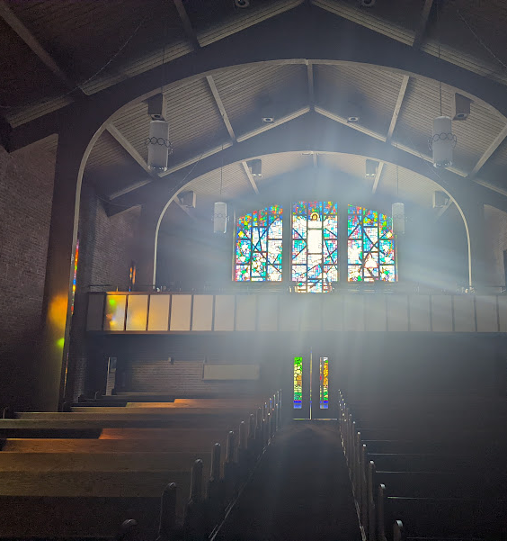
Administration
2-3 Admins (not a free for all)
A few weeks out
Include day before and even day of reminders of things like worship, Bible study, events etc.
You can use Facebook’s internal scheduler or an external scheduler, or just set a reminder and copy and paste it from a document.

Slide 21
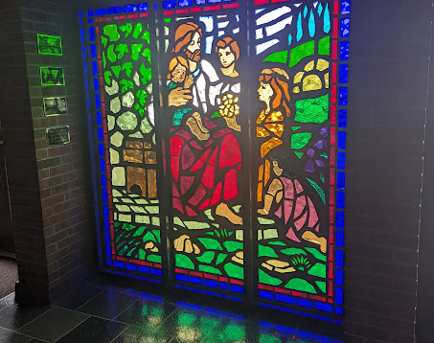
Posts – Readability And Attractiveness
Pictures – tasteful, interesting, not-copyrighted
Take pictures of your church and church folk
Get permission to share
Sometimes just fun
Sometimes information or historic

Slide 22
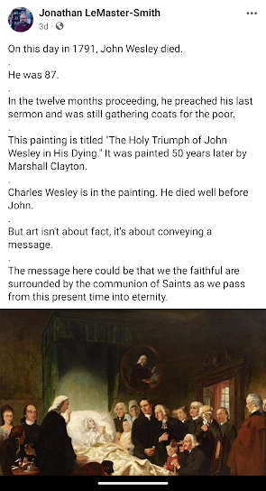
Posts – Readability
Most people are reading on their phone or tablets
Can be brief or long
Space out well/no huge clumps
Have a divider every one to two sentences
I use a period, others use emojis or symbols

Slide 23
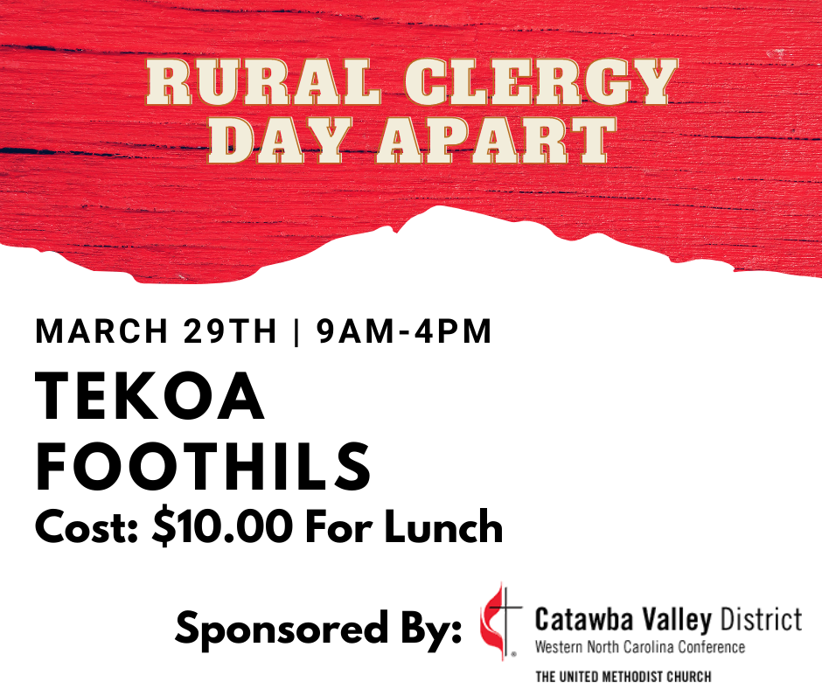
Posts - Use Graphic Apps to create simple visuals
Canva
Quotes Creator
Photoshop/Indesign

Slide 24
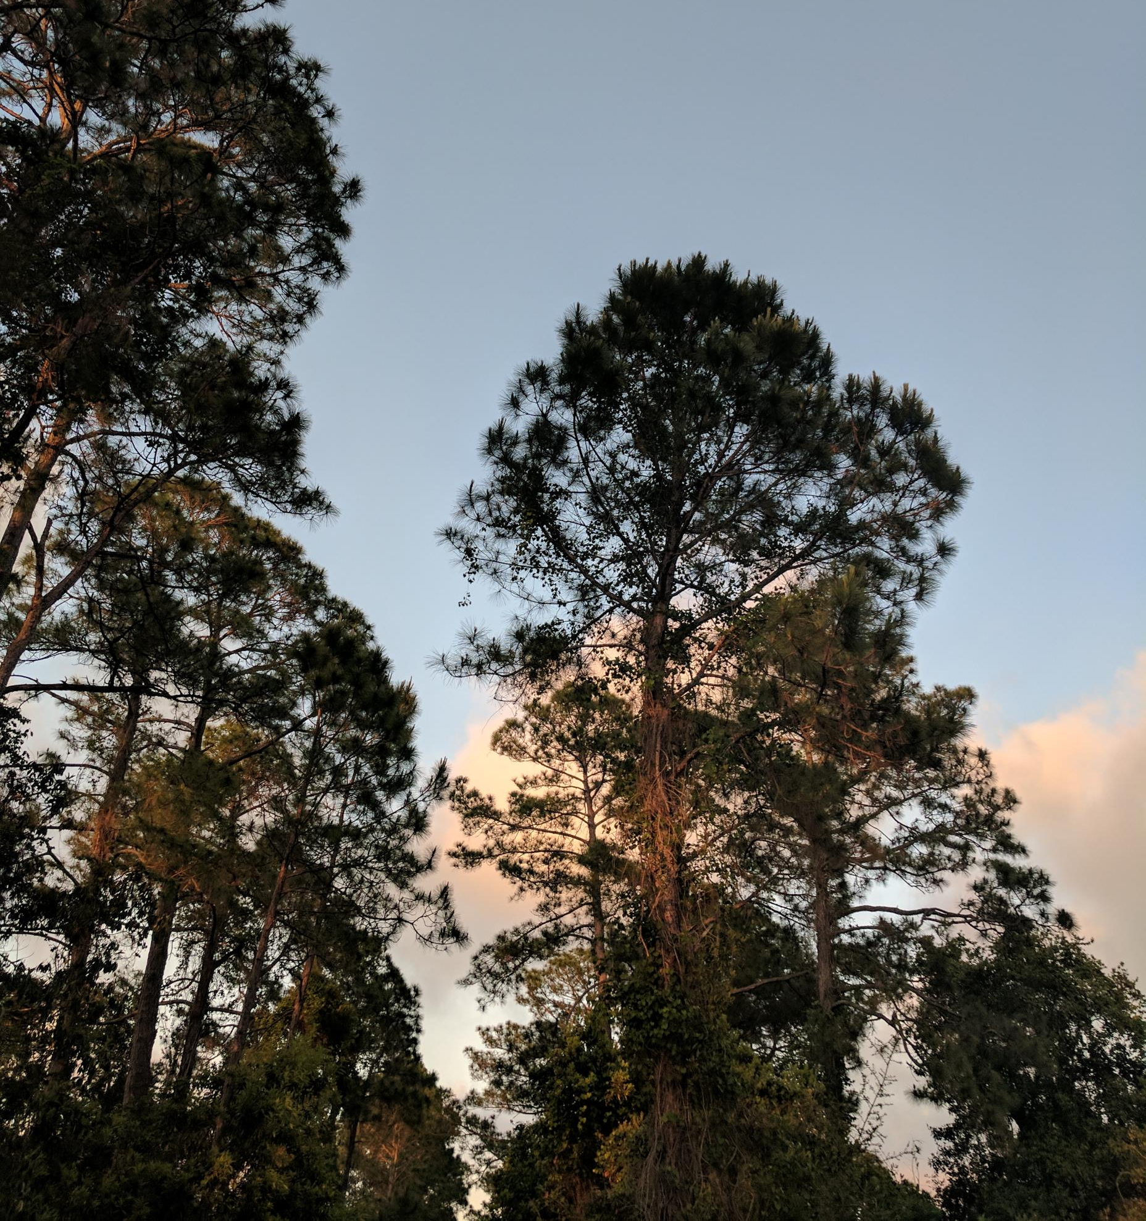
Posts - Links
You can post links
But in the comments is better
Make sure the link works

Slide 25
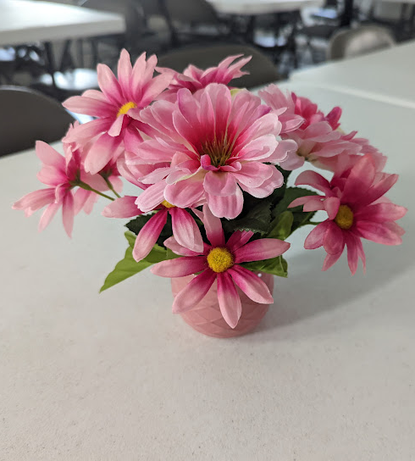
Events
Use these for events you want to raise money with or good attendance
Most people will be interested, but may not attend
Be clear in it, and have ways to contact

Slide 26
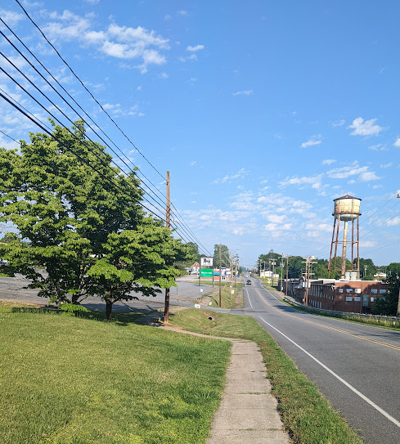
Monitor Your Pages
Scammers Jump In
People will argue
Sometimes people have important questions

Slide 27
Use Rural Means of Communication
Have your people share, especially your popular people
Get other churches and businesses
More shares = more impression
Encourage people to share it with others offline

Slide 28
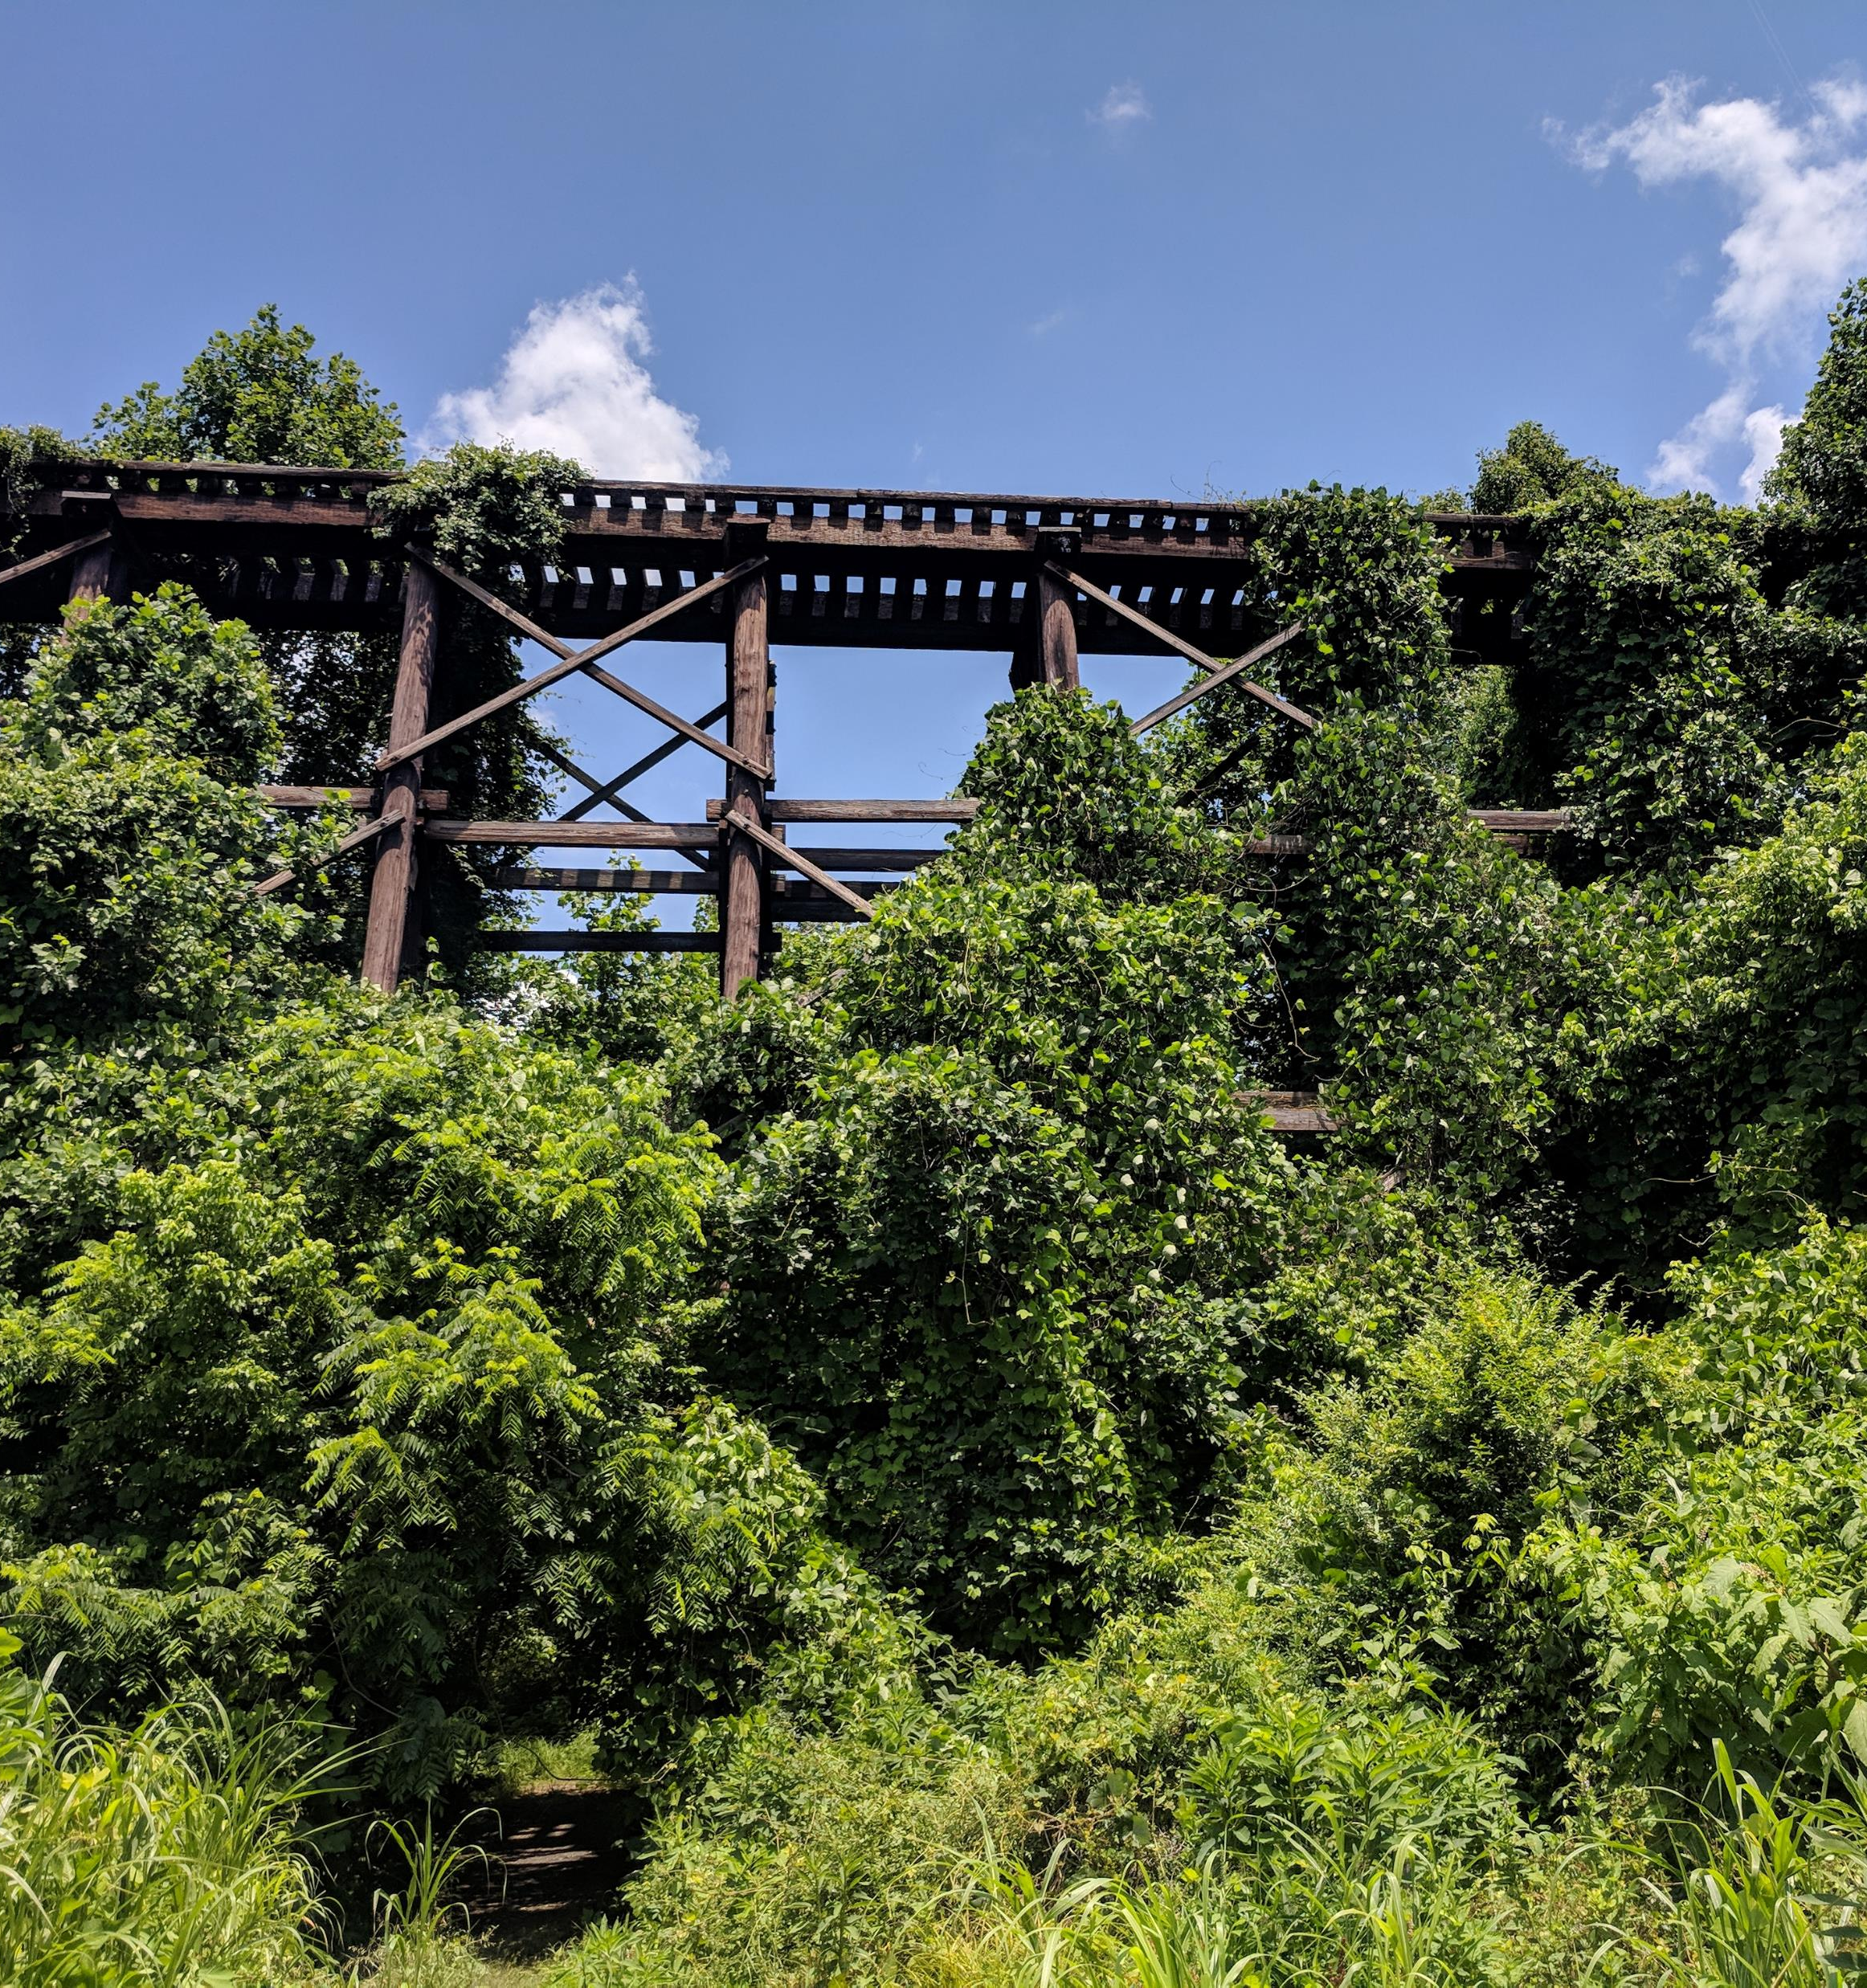
Reels and Videos
Do not have to high quality
Authentic videos are good
Does not have to be whole services
Singings
Devotions
Announcements

Slide 29
Questions and Comments

Slide 30
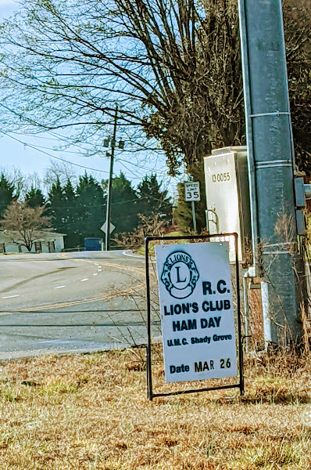
My Information
Jlemaster-smith.com
Rusty Water Towers Podcast
Facebook.com/j.lemaster-smith
theruralprofessor@gmail.com

