Slide 1
Year Round Stewardship
Notes:
Since most of you here today are communicators, it may seem odd for us to be talking about Year Round Stewardship. You may be thinking this is something a stewardship team needs to hear, not a bunch of communications folks. I hope that at the end of our time together today you will be able to see what a vital role you can play in nurturing the spiritual practice of stewardship by fostering a healthy year round stewardship program in your parish.
.
Before we talk about Year Round Stewardship, we need to know what Stewardship is. The finance people don’t like for me to say this, but – Stewardship is NOT about the budget. Budgets are a real and necessary part of the world, but when hearts are open to understanding then the budget will take care of itself. God will get us where God wants us to go if we are open to it. So what is Stewardship?
Everything I have is a gift from God. “The world and all that is in it is mine, sayeth the Lord.” So every material thing and every talent I have is a gift from God. So, simply put, stewardship is using the gifts God has given me to do the work God is calling me to do. ***

Slide 2
Why Year Round Stewardship
Stewardship is what we do with all that God has given us, all the time – Not the “annual beg-a-thon”
Takes stewardship out of the "annual occurrence" category and places it where it should be - right in front of us, all year round.
Strengthens and supports members of the congregation in their knowledge and understanding of their roles as God’s stewards
Develops and strengthens stewardship theology in the parish
Changes the culture by changing the conversation in non-threatening ways
Notes:
Why is Year Round Stewardship important? ***
Stewardship is what we do with all that God has given us, all the time – Too often, people think that stewardship is just a code word for the “annual beg-a-thon”.***
Takes stewardship out of the "annual occurrence" category and places it where it should be - right in front of us, all year round. ***
Strengthens and supports members of the congregation in their knowledge and understanding of their roles as God’s stewards ***
Develops and strengthens stewardship theology in the parish ***
Changes the culture by changing the conversation in non-threatening ways ***

Slide 3
Who Should Be Involved?
Leaders
Adults
Youth
Children
Notes:
Who should be involved with Stewardship? Clergy & Lay Leadership, Adults, Youth, Children…?
EVERYONE! ***

Slide 4
Clergy & Leadership
Don’t tell me you’re trusting God until you trust Him with your pocketbook.
J. Vernon McGee
Notes:
Let’s start with the hardest group – Clergy and Leadership. When leadership doesn't lead, the group depending on leadership doesn't make progress. Let me say that again: When leadership doesn't lead, the group depending on leadership doesn't make progress. This is an essential truth for us as we encourage generosity for the purpose of doing God's work in the world. Regardless of what your formal title is, as a person responsible for communicating the work of the church, you are in a leadership position. So how do we – as clergy and lay leadership – lead in regards to stewardship? ***

Slide 5
“It is difficult for leaders to lead where they have never gone or are afraid to venture” Melvin Amerson
Preach it, Preacher!
Vestry Stewardship Statement
We believe everything we have comes from God. Therefore, as faithful stewards, we are called to share all that we are and all that we have abundantly and joyfully to further God’s kingdom.
We commit to love our neighbors as God loves us through word and deed; to build community by serving and caring for the needs of others; to challenge our fears of scarcity; and to work towards the biblical standard of tithing 10% of our annual income.
We invite you to join us by embracing the promises of God’s abundant blessings, and giving cheerfully, generously, and gratefully for all God entrusts to you.
Notes:
Preach it, Preacher! Encourage Clergy, incorporate stewardship into your sermons all year – not just in the weeks preceding your annual campaign. Avoiding talking about the spiritual practice of stewardship from the pulpit is doing a disservice to God and the congregation. ***
Vestry Stewardship Statement As leaders, how can you ask the congregation to do something that you haven’t even really spent much time considering?
A vestry stewardship statement is developed by the vestry during a workshop with the help of a facilitator. With Bible study and some serious discernment, we develop a comprehensive 3-part statement that everyone has to agree on: We Believe…, We Commit…, We Invite… Then you frame it, put it on the wall, and publish it, website.
Example: ***
We believe everything we have comes from God. Therefore, as faithful stewards, we are called to share all that we are and all that we have abundantly and joyfully to further God’s kingdom. ***
We commit to love our neighbors as God loves us through word and deed; to build community by serving and caring for the needs of others; to challenge our fears of scarcity; and to work towards the biblical standard of tithing 10% of our annual income. ***
We invite you to join us by embracing the promises of God’s abundant blessings, and giving cheerfully, generously, and gratefully for all God entrusts to you.
Developing a vestry stewardship statement not only facilitates the members of your vestry getting clear about what they believe as individuals and as a leadership body, but it also gives the vestry a vehicle to offer public reflection about how each person experiences God in the midst of financial decision making. ***
Alternate example:
We believe God is the source of all gifts, spiritual and material. Our faithful response, in gratitude, is to be givers and creators our­selves. While we strive to be good stewards of all God's gifts to us, we believe that the way we use our money reflects the state of our spiritual lives.
We commit to follow Christ in community. In prayerful witness to our faith, each of us is already tithing or is committed to working towards the tithe.
Our experience is that joyful giving results in spiritual growth. We invite the parish to join us in this commitment to deepening our faith.

Slide 6
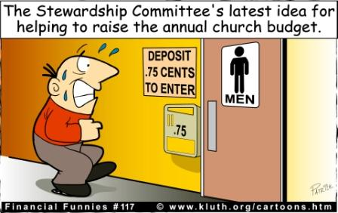
“It is difficult for leaders to lead where they have never gone or are afraid to venture” Melvin Amerson
Newsletter
Monthly Article - Stewardship, the word, comes from the Old English term sty-ward and reflects the practice of appointing reliable workers to be wardens of the pig sty; thus, sty-wards. “From The Pig’s Sty”
Stewardship Cartoons
Stewardship Quotes
Sunday Bulletin
Financial Updates
Stewardship Quotes
Thank You Notes
Vestry
Ministry Team Leaders
Clergy
Notes:
Newsletter
Monthly article in the newsletter - Doesn’t have to be “heavy”. Stewardship, the word, comes from the Old English term sty-ward and reflects the practice of appointing reliable workers to be wardens of the pig sty; thus, sty-wards. “From The Pig’s Sty”
Cartoons
Quotes – Google ***
Sunday Bulletin
Financial Updates
Quotes ***
Thank You Notes
Most underutilized tool we have. We underestimate the power of a thank you note. There are some very easy ways to get into the habit of regularly sending thank you notes. ***
Vestry thank you notes – one (or more) per month to a parishioner acknowledging their service.***
Once per month from ministry team leaders. ***
Clergy – list of every person involved in ministry, write 4-8 each month & check them off the list
Saying Thank You is being a good steward of your most valuable resources – people. ***

Slide 7
Children
Train up a child in the way he should go: and when he is old, he will not depart from it.
Proverbs 22:6
Notes:
We did the hardest group; now let us look at the easiest group – Children. ***

Slide 8
Children’s Giving Envelopes
Notes:
Children’s offering envelopes – Low hanging fruit
Can buy 100 online for $5.19 or make your own. I designed this envelope to match our annual campaign. Our theme was “Start by doing what’s necessary, then what’s possible, and suddenly you are doing the impossible.” – St. Francis Assisi, these looked similar to the adult’s pledge cards. We are a low budget church, so we printed these in house on small envelopes from Staples.
If you do design your own, make sure to always include time and talent with money.
Make available in Sunday school classes and narthex or entrance to your church
Publish what the children are doing in your bulletins and newsletters
Not only do the envelopes allow children to participate in the offertory with their OWN gifts, but then because you have published their good deeds in the bulletins and newsletters, they are celebrated by the adults and the behavior is reinforced.
In addition to teaching children about stewardship, it helps keep stewardship in daily conversation with the adults ***

Slide 9
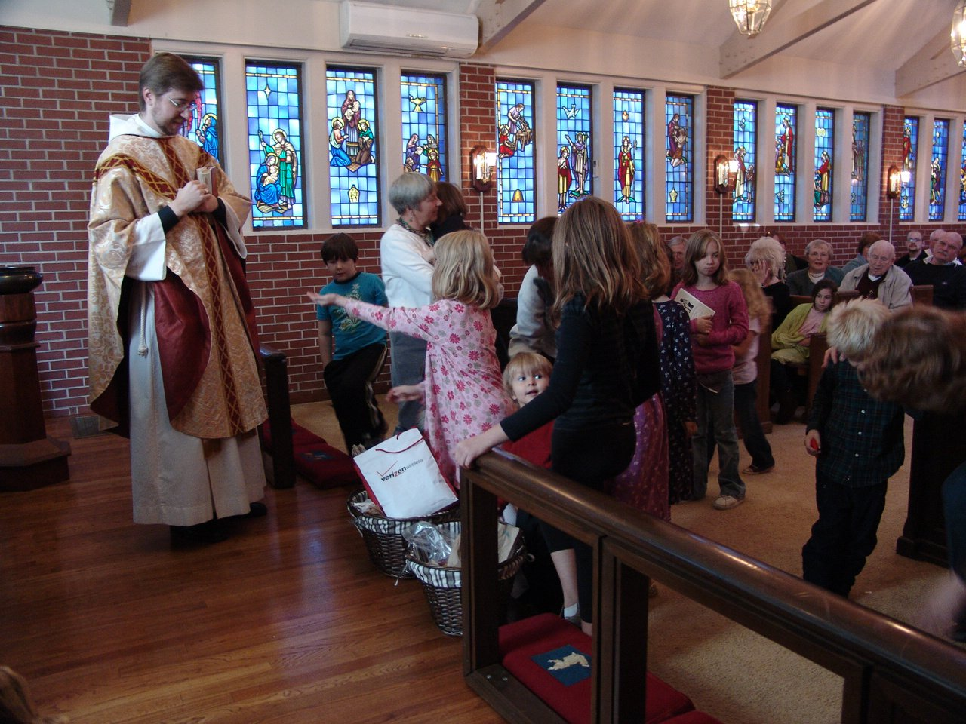
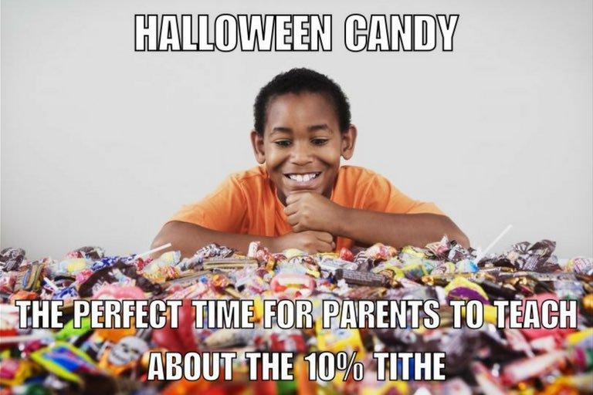
Candy Tithe
Notes:
Candy Tithe
Candy is as close to currency as you can get for children.
Have children bring 10% of their Halloween candy to the altar the Sunday following Halloween, have it blessed, and donate it to homeless shelter or other organization. Like the envelopes, this celebrates the children’s giving and reinforces the behavior.
As communicators, you can help build excitement and support by making sure everyone is talking about the Candy Tithe in the weeks prior to Halloween. You can have the children bring their offering up in their own paper bags, etc. or you could create a special bag or box for them to put the candy in (like a mite box).
And, again, although this is aimed at the children, it also gets the adults talking about the “t-word”.
Story of Libby – wined and complained for weeks before Halloween about the candy tithe. Halloween night mom helped her separate out 10% of the candy. “Wait? That’s it? Really?! Oh, that’s not enough.” Voluntarily gave more than her tithe. In that moment, she leaned a tangible, lifelong lesson about tithing. ***

Slide 10
Youth
Let no one despise you for your youth, but set the believers an example in speech, in conduct, in love, in faith, in purity.
1 Timothy 4:12
Notes:
Youth
Most teenagers inherently understand stewardship. We just need to provide them with the language to articulate what they already believe as “stewardship”.
Research shows us that Generation Z (those under 21) are so highly motivated to support philanthropic causes that result in a better world that they see it as an important part of their identity.
44% give to charity and average of $341 across 4.6 charities
2% of all giving ($3.2 billion/year) ***

Slide 11
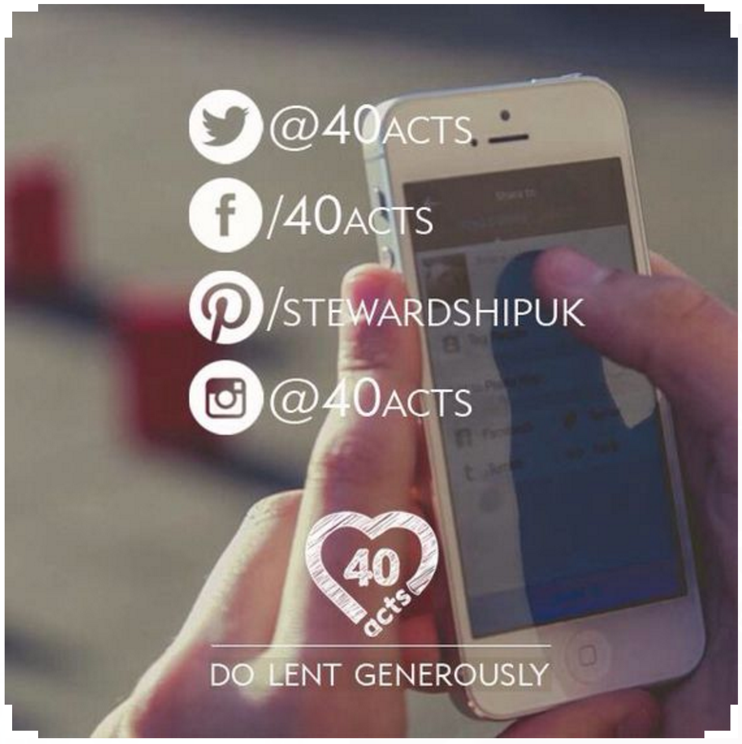
40 Days, 40 Acts of Generosity:
40 days of giving back, doing good and living generously
www.40acts.org/uk
Notes:
40 Acts: Do Lent Generously – 40 DAYS, 40 ACTS OF GENEROSITY: 40 days of giving back, doing good and living generously
The online challenge encourages people to make generosity and kindness a habit. It is not only about money, but also being generous with your time, words and actions.
Find this program at www.40acts.org/uk
This program consists of an email each day of Lent with an inspirational daily reflection, a prayer, and 3 levels of challenge: Green, Amber, Red. Green is the easiest level, which are the quickest and usually free ideas. Amber, ‘a little more challenging than green, taking no longer than 15 min or less’. And Red, ‘for those who love to push themselves!’
These are simple things, but they can have a big impact. Story from Starbucks: At a drive through a driver decided to pay for the coffee of the driver behind them. This continued for two and a half hours!
You are encouraged to share your experience on social media. A few years ago, one of the churches in our diocese did it as a whole congregation and they really encouraged people to post their experiences on social media. There was one day when the challenge was to give away candy bars to strangers. It was so much fun to watch the joy they experienced in giving away chocolate. And, again, we are teaching (in subtle ways) about the joy of giving.
This program originally was automated. Individuals would sign up on 40Acts.org and they would receive the daily emails, etc. Last year, that ended. However, they have made the entire program available to download. So, instead of the emails being automated, you can download the program, and then you would need to copy and send out the daily emails. You could schedule all of the emails to be sent. You could also post the daily reflections and/or challenges online.
In addition to daily emails, there are also resource materials for doing 40Acts as a high school youth group, middle school youth group, children’s Sunday school, adult Sunday school, family, and small groups.
Strongly encourage this for the ENTIRE parish – can be very unifying, but it is particularly appealing to the youth because of social media component. And, of course, how effective the social media component is is largely up to you all as the communications folks.***

Slide 12
Everyone
Now is our time to go. To go into the world to share the good news of God and Jesus Christ. To go into the world and help to be agents and instruments of God’s reconciliation. To go into the world, let the world know that there is a God who loves us, a God who will not let us go, and that that love can set us all free.
This is the Jesus Movement, and we are The Episcopal Church, the Episcopal branch of Jesus’ movement in this world.
- Presiding Bishop Michael Curry
Notes:
What are some easy ways we can get everyone involved in year round stewardship? ***

Slide 13
Make Stewardship An Everyday Word
Recycling – Thanks for practicing good stewardship!
Incorporate the term into meetings – Instead of “What should we spend our budget on?” try “How can we be the best stewards of these resources?” or when considering a purchase, “Is this practicing good stewardship?”
Province I: “Turn the lights off, for God’s sake” – Because reducing energy use is an act of stewardship both of God’s good creation and of financial resources.
Notes:
Make Stewardship and everyday word ***
Recycling – Thanks for practicing good stewardship! On your containers. As communicators, we know this is branding. If you are the person who makes the signage, this is a great way to encourage stewardship.***
Incorporate the term into meetings – Instead of “What should we spend our budget on?” try “How can we be the best stewards of these resources?” Or when considering a major expenditure “Is this practicing good stewardship?” Words matter. ***
Instead of “Please turn off the lights”, “Please practice good stewardship by turning off the lights!” ***
Province 1 (New England) has a campaign called “Turn the lights off, for God’s sake” because “reducing energy use is an act of stewardship both of God’s good Creation and of financial resources” ***

Slide 14
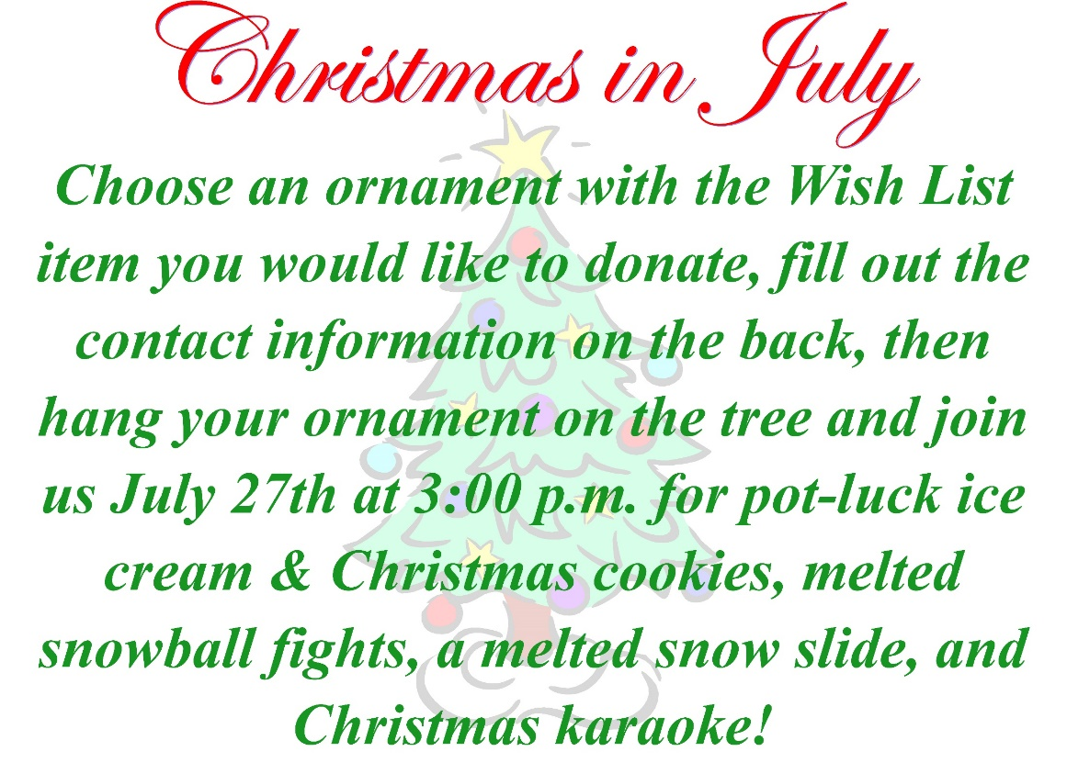
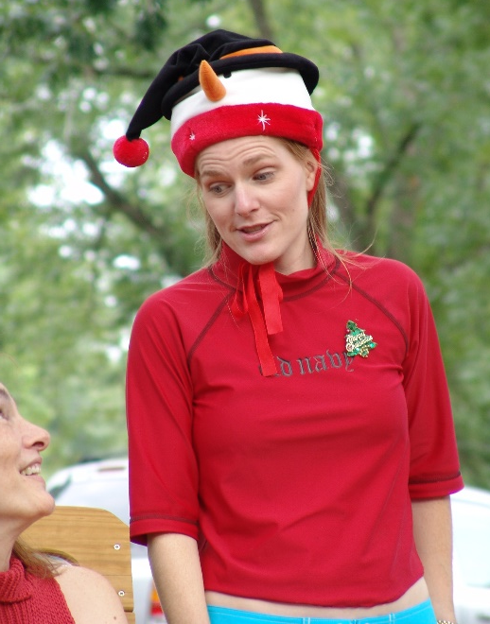
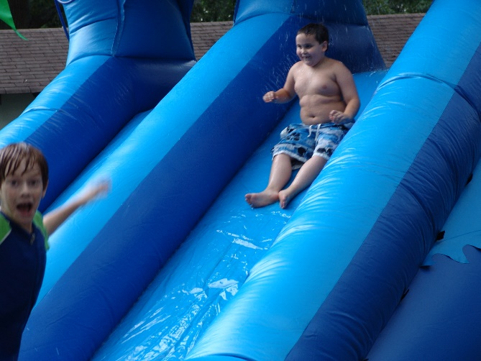
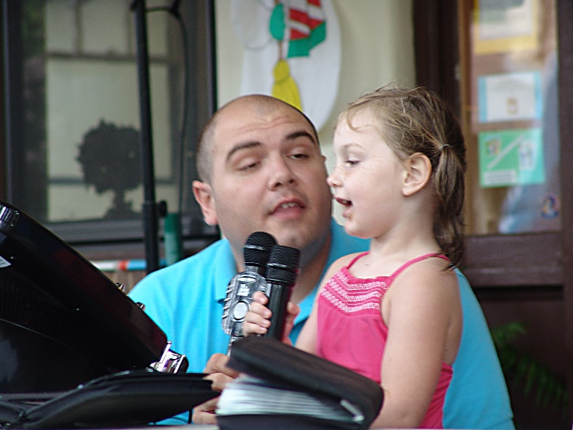
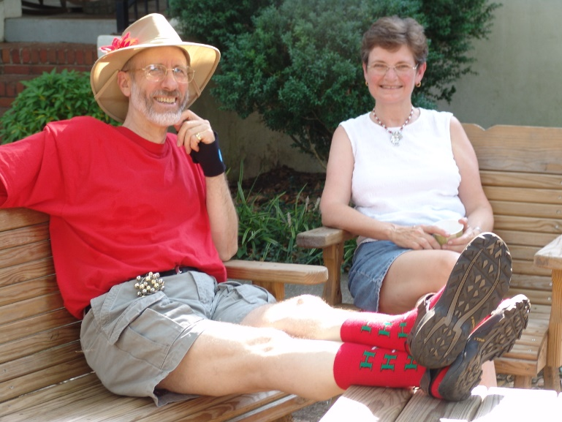
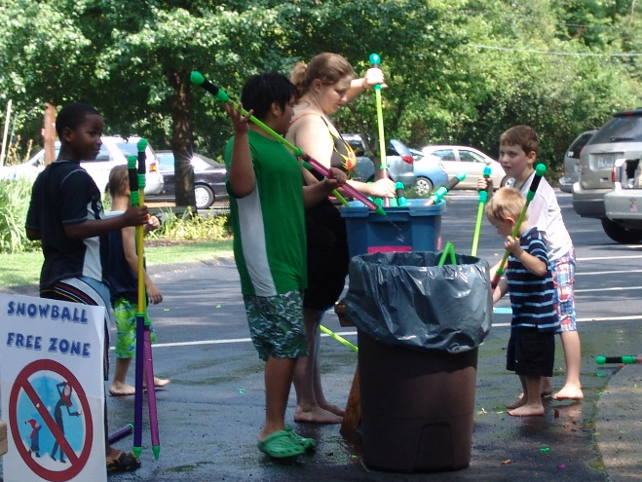
FUN Events – Not Just Annual Campaign
Notes:
Fun events – not just annual campaign - Christmas in July
Santa is on vacation, we have to step up.
Have each ministry team make a “wish list” – include tasks, big and small items (elevator/matches)
Post wish list in parish hall
Tree with lights no ornaments
Children make ornaments, but can only be hung on tree when someone takes an item off the wish list and writes it on the ornament
Day of event –
Pot luck ice cream and Christmas cookies
Christmas karaoke on the porch
Melted snow slide (aka water slide)
Melted snow ball fights (aka water balloons)
Gets everyone involved, creates church wide bonding through fellowship, gets much needed items for ministries (our sacristy won’t have to buy silver polish for years!), and, most importantly, gets people to think of stewardship in a new (positive) way. ***

Slide 15
Year Round Stewardship Calendar
Based on work by the Diocese of West Texas
tinyurl.com/yearroundstewardship
Notes:
In a well-executed stewardship program, there is something planned for stewardship every month. Although that sounds overwhelming, it doesn’t have to be. I want to share with you a resource that makes it easy to design and implement stewardship related programs every month of the year.
The Diocese of West Texas developed a great framework for a year round stewardship calendar. We started with their basic framework, then customized and expanded it for the Diocese of Atlanta to create a 63 page year round stewardship program. You can download the book at https://tinyurl.com/yearroundstewardship
The program gives congregations suggestions and resources for practicing year ‘round stewardship each month of the year.
Every month, the church season is explained
And a theme is identified around which individual and congregational activities might take place in five recurring categories: ***

Slide 16
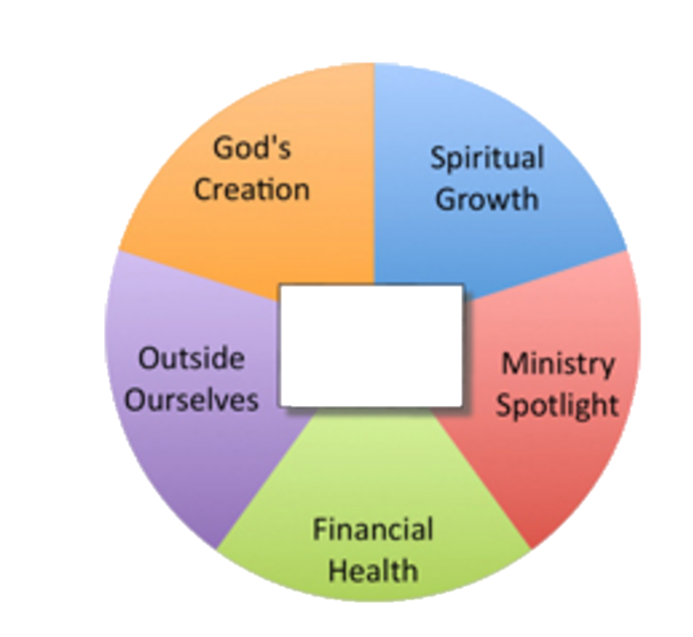
Spiritual Growth
Offers ways to deepen the spiritual lives of individuals and the congregation.
Ministry Spotlight
Focusing on a different ministry each month is a way of giving thanks for that ministry and raising awareness about it to attract new participants. Encourages saying “thank you”.
Financial Health
Offers focus on fiscal responsibility, can communicate leadership’s good
stewardship of the congregations resources. Also offers many ways families can
be intentional about how they manage their money including what they are saving and what percentage of their income they are giving away.
Outside Ourselves
In outreach we take our stewardship to the streets of our communities. These activities help people connect their pledge to ministry. Communicating and celebrating the stories of meeting the needs of people are important motivators for personal stewardship decisions.
God’s Creation
How we care for the environment that God has entrusted to us is a mark of our faithfulness. This category can include caring for the environment in our communities, in our homes, and in our churches.
Notes:
Spiritual Growth – Offers ways to deepen the spiritual lives of individuals and the congregation. ***
Ministry Spotlight – Focusing on a different ministry each month is a way of giving thanks for that ministry and raising awareness about it to attract new participants. Encourages saying “thank you”. This is one area where communicators can play a crucial role. ***
Financial Health – Offers focus on fiscal responsibility, can communicate leadership’s good stewardship of the congregations resources. Also offers many ways families can be intentional about how they manage their money including what they are saving and what percentage of their income they are giving away. ***
Outside Ourselves – In outreach we take our stewardship to the streets of our communities. These activities help people connect their pledge to ministry. Communicating and celebrating the stories of meeting the needs of people are important motivators for personal stewardship decisions. If you aren’t doing outreach, people won’t give. And, even if you are doing great outreach, but people don’t know about it, they won’t give. As communicators, it often falls on you to make sure that everyone knows what good work is being done by the parish.***
God’s Creation – How we care for the environment that God has entrusted to us is a mark of our faithfulness. This category can include caring for the environment in our communities, in our homes, and in our churches. ***

Slide 17
Notes:
For example, this is the planning guide for September. It starts by talking about what season we are in – Ordinary Time. It describes fall as a time of reconnecting with those who have been gone for the summer as well as a time of welcoming newcomers to the community.
It identifies the theme as the Rhythm of Fall – a time of returning to our normal routine with the return of school.

Slide 18
Notes:
Then there are quite a few suggestions for each of the five categories. The idea is to make this as easy as possible, so most of these suggestions include specific resources. For example, rather than only suggesting a Bible Study, it offers a specific Bible study programs related to the theme.

Slide 19
Notes:
September’s ministry spotlight is on Youth Ministry and includes several ideas for recognizing and thanking members of this ministry.

Slide 20
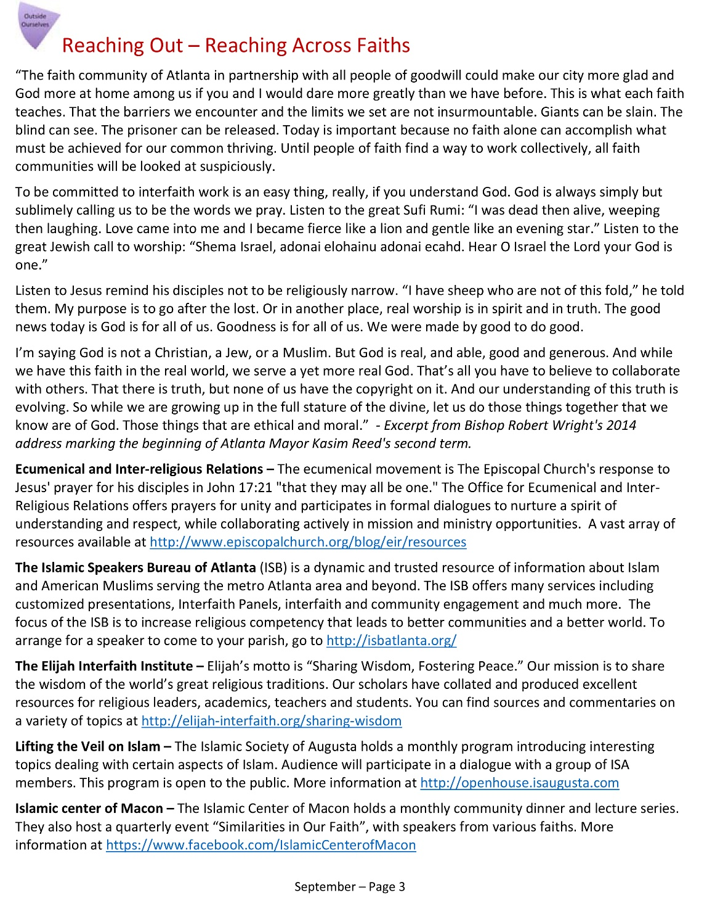
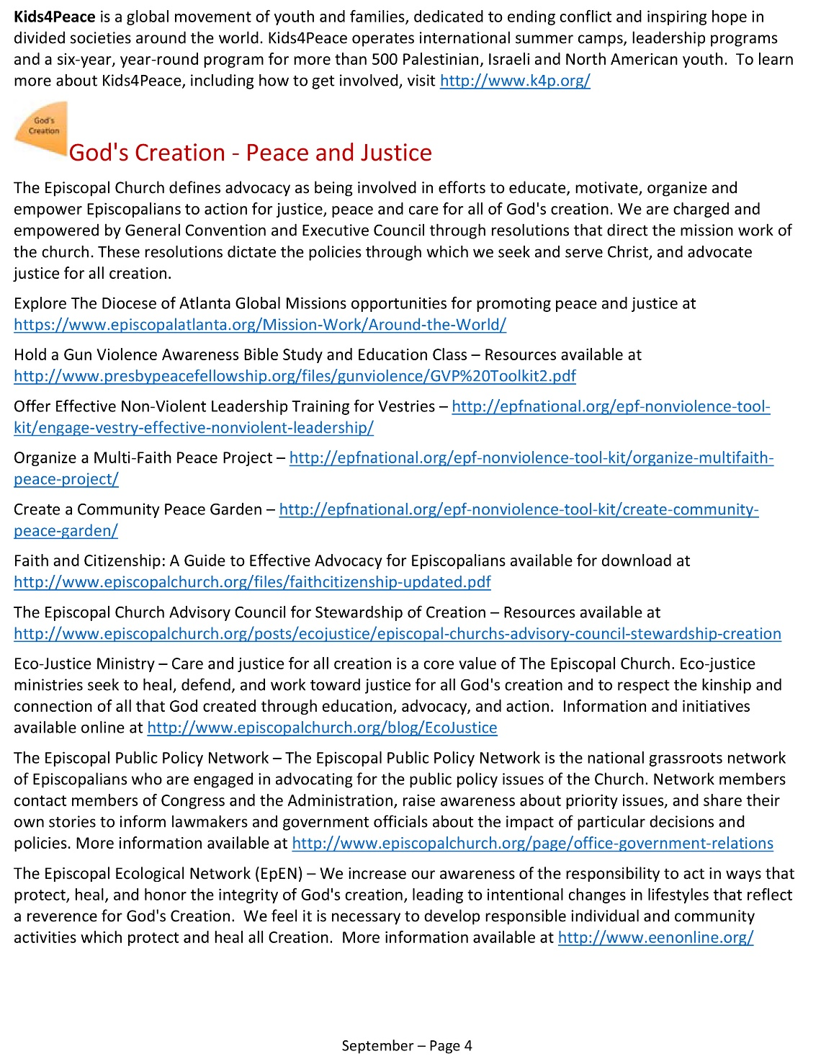
Notes:
To give you a taste of how many ideas are under each of the five categories, here you can see Reaching Out and God’s Creation.

Slide 21
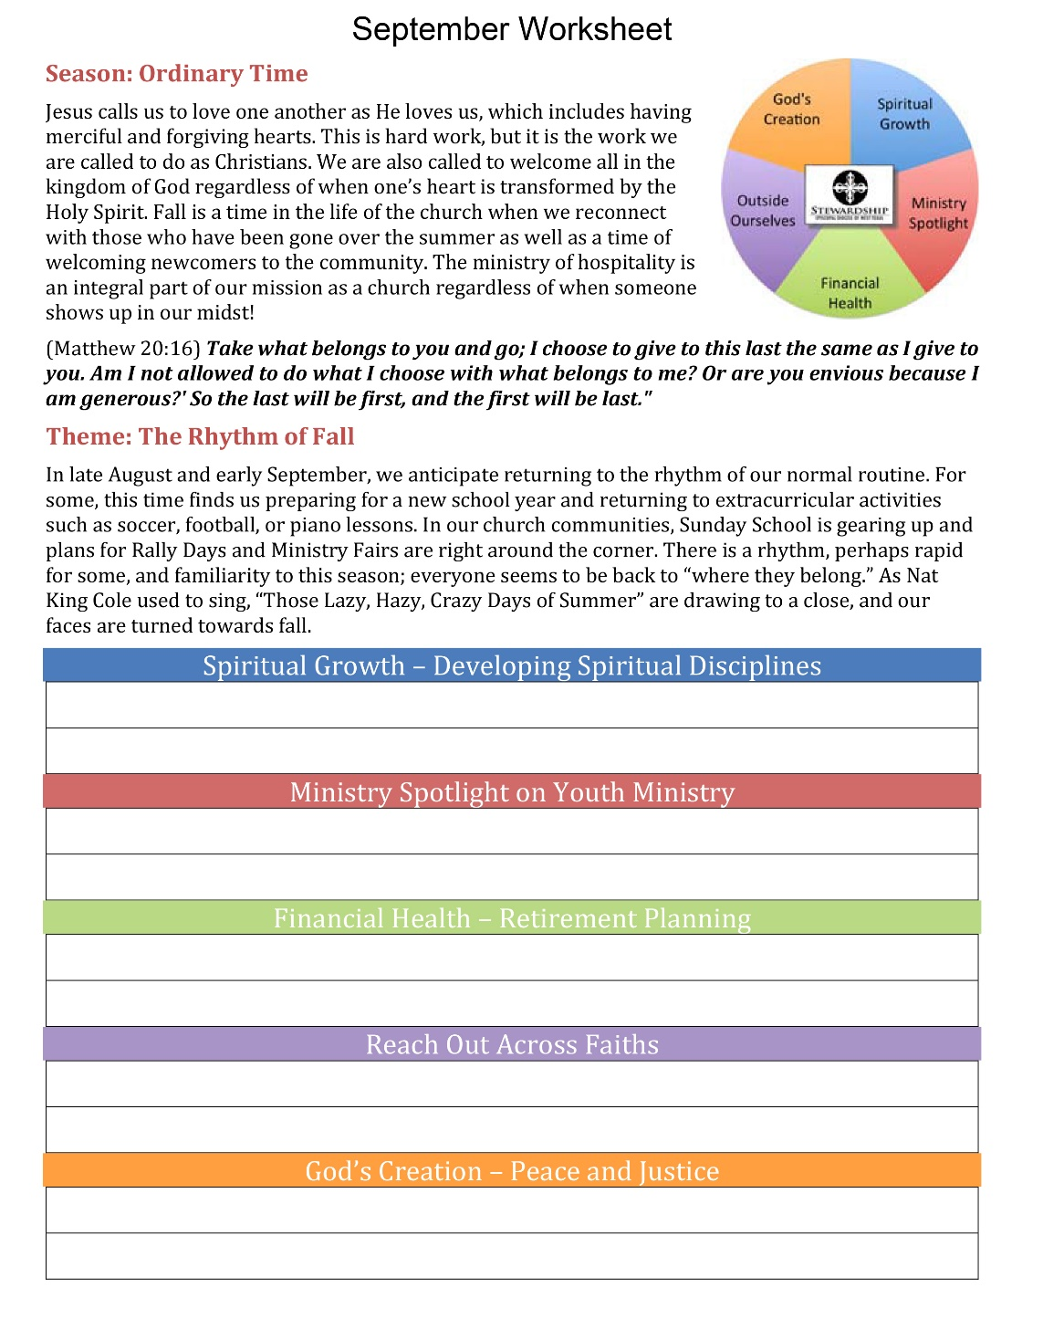
Notes:
In addition to the planning guide, each month also includes a Worksheet. The top half of the page describes the season and theme for the month. The bottom half of the page list each of the five categories with their focus for the month, followed by a space to fill in one or more activities under each category.
You look at all of the ideas under spiritual growth and pick one – say Centering Prayer – and write it under the Spiritual Growth category. Then you do the same thing for each category. ***

Slide 22
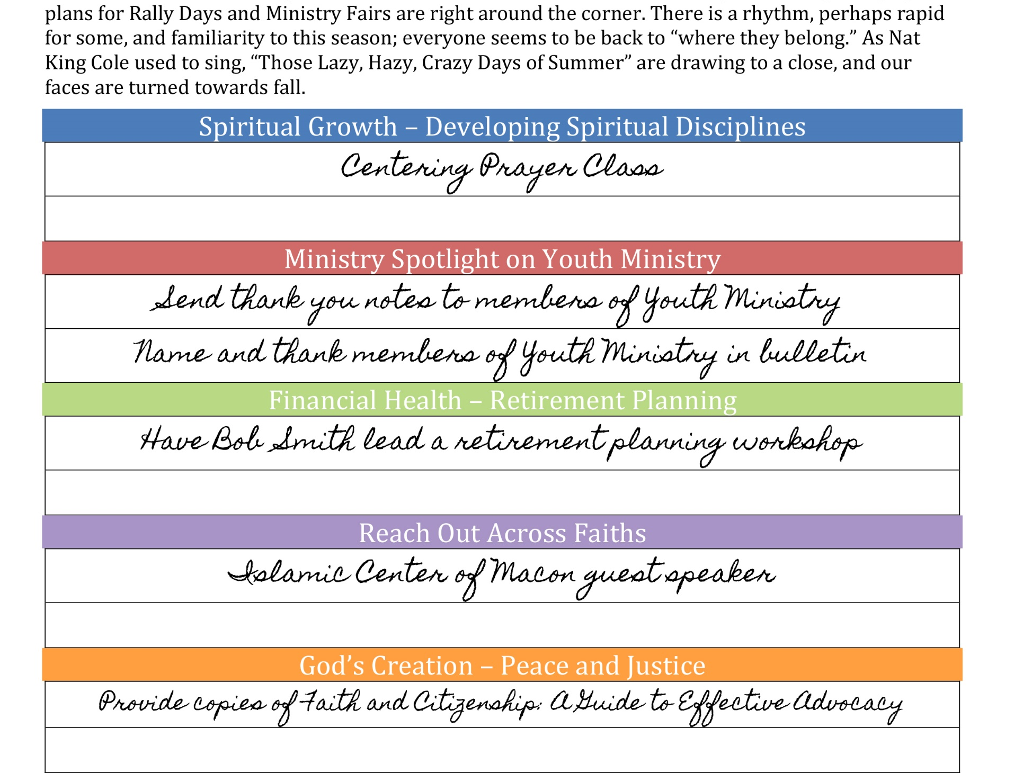
Notes:
So your completed worksheet may look like this:
Have a Centering Prayer Class
Send thank you notes to members of the youth ministry & name and thank youth ministry in bulletin
Have Bob Smith lead a retirement planning workshop
Contact the Islamic Center of Macon about having a guest speaker
Publicize and provide copies of Faith and Citizenship: A Guide to Effective Advocacy for Episcopalians
Remember – This planning guide is a starting point, tailor ideas for your congregation. If your parish already does something that isn’t listed – like a bake sale to raise funds for a homeless shelter – by all means, include that on your sheet. Or, if you already plan on having an End of Life workshop, list it as an activity under financial health.

Slide 23
Words of Wisdom
Divide and Conquer!
Start by assigning each person on the Stewardship Committee or Vestry one month to plan.
Each person should complete their assigned month’s worksheet with one idea in each of the five categories.
Compile the worksheets completed by the individual members of the committee.
As a committee, review each of the 12 worksheets (looking at them as part of the whole) and make any needed adjustments.
Notes:
Words of Wisdom – ***
Divide and Conquer
Start by assigning each person on the Stewardship Committee or Vestry one month to plan. ***
Each person should complete their assigned month’s worksheet with one idea in each of the five categories. (My husband is not Episcopalian and does not speak Episcopal, so I used him as my test case. I gave him the month with the most options and he completed it in 7 minutes. ***
Compile the worksheets completed by the individual members of the committee. ***
As a committee, review each of the 12 worksheets (looking at them as part of the whole) and make any needed adjustments. We did this at a diocesan Vestry retreat several years ago with about 10 different vestries in the room. Within 30 minutes, each parish had a comprehensive, 12 month stewardship plan in writing. ***

Slide 24
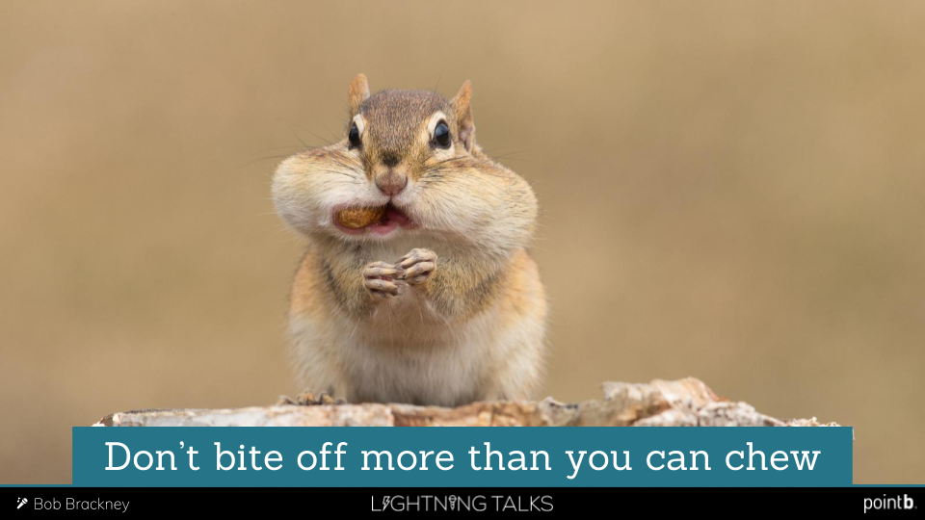
Words of Wisdom
Notes:
Bite Sized Pieces
Although it would be great to do the activity in all five of the categories every month, that’s probably not going to happen. That’s okay! Execute as many as you can do well, but do at least one every month. Keep in mind that you were probably already planning on doing a lot of these things already. For example, in Atlanta, a large number of our parishes participate in The Hunger Walk to raise money for the Episcopal Charities Foundation and the Atlanta Food Bank. The Hunger Walk is one of the ideas in Reaching Out. We aren’t asking you to take on extra things as much as we are asking you to reframe them through the lens of stewardship. And you are in the ideal position to do this because, as communicators, you have a birds eye view of what’s happening at your church. You are able to see the big picture. So, as you see things coming up on the schedule, think of them through the lens of stewardship and how they may be reframed and communicated as practicing good stewardship.
It’s also important to keep in mind that if you can do nothing else, the Ministry Spotlight takes minimal time and energy. That can be as easy as asking the members of the altar guild to stand during worship and talking about what they do, and asking the congregation to give them a big round of applause to say thank you. *

Slide 25
Words of Wisdom
The More The Merrier!
Spiritual Growth – Partner with Worship Committee and/or Adult Christian Formation Committee
Ministry Spotlight – Partner with Communications Committee and/or Pastoral Care Committee
Financial Health – Partner with Finance Committee
Outside Ourselves – Partner with Outreach/Community Ministries Committee
God’s Creation – Partner with Green Team/Creation Keepers/Environmental Committee
Notes:
The More The Merrier ***
Remember – the members of the Stewardship Committee do not have to be the ones to execute each idea. Get other ministries involved! ***
Spiritual Growth – Partner with Worship Committee and/or Adult Christian Formation Committee ***
Ministry Spotlight – Partner with Communications Committee and/or Pastoral Care Committee ***
Financial Health – Partner with Finance Committee ***
Outside Ourselves – Partner with Outreach/Community Ministries Committee ***
God’s Creation – Partner with Green Team/Creation Keepers/Environmental Committee
As the communications folks, you can help facilitated this collaboration if you are looking at things through the lens of stewardship.***

Slide 26
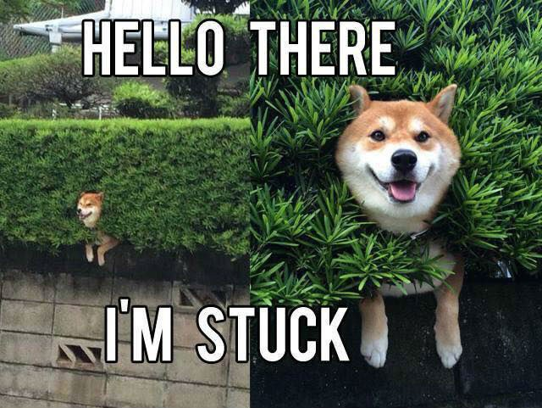
Words of Wisdom
Notes:
Help Is Available!
The Diocese of Atlanta Commission on Stewardship is available to help. Please don’t hesitate to contact us if you have questions or need assistance. ***

Slide 27
Tammy E. Pallot, M.S. Episcopal Diocese of Atlanta Commission on Stewardship tammypallot@gmail.com 478-954-5441
Notes:
As I said in the beginning, I hope that you are able to see what a valuable role you play in nurturing the spiritual practice of stewardship by fostering a healthy year round stewardship program in your parish. How ideas and events are presented matter. If your church is anything like mine, all too often, people send you the bare bones information about events and it is up to you to publicize them in a meaningful way. Words matter. Connecting the dots between giving and ministry matters. You are in the unique position to be able to do this with language and imagery. You are a powerful force for ministry and, as I said before, the Diocese of Atlanta’s Commission on Stewardship is here to help and support you in any way we can.

